Slide 1

Global SEA LEVEL CHANGE
Situation through
Last 100 years
And what’s next?
Prepared by
Mihail Cazac
IA-214

Slide 2

Goals
Based on this data set, I propose to:
explain long term sea-level change
predict short term sea-level change
make conclusions about human contribution at the process of sea-level rise

Slide 3

Dataset OVERVIEW
Name: “Sea level changes and contributing factors’ dynamics”
Common info:
Provider: “NASA GRACE”
Type: Numerical
Size: 264 entries
Formatting: .csv
Common info:
Provider: “NASA GRACE”
Type: Numerical
Size: 264 entries
Formatting: .csv
Target Variables:
“Sea level”,
“Air Temperature Anomaly”,
“CO2 emissions

Slide 4
Dataset OVERVIEW: Target variables
 | Sea Level Change | Air Temps | Ocean Temps Anomaly | CO2 emissions | Year
Length | 271 | 271 | 271 | 271 | 271
Class | float | float | float | float | integer
Mode | numeric | numeric | numeric | numeric | numeric
Min | -0.44 | 7.8 | -5.94 | 1.4 tr.t. | 1880
Max | 9 | 9.9 | 14.842 | 1.5 tr.t. | 2015
 | CO2 in Air | Urbanization | Sea Ice Area | Land Ice Mass | Water Consumption
Length | 271 | 271 | 271 | 271 | 271
Class | float | float | float | float | float
Mode | numeric | numeric | numeric | numeric | numeric
Min | 336.9 | 11.9 | 10.99 | -151.9 | 6.5
Max | 399.6 | 59.9 | 12.98 | -5467.5 | 40.7
It is expected to detect (confirm) the presence of an association among target attributes

Slide 5

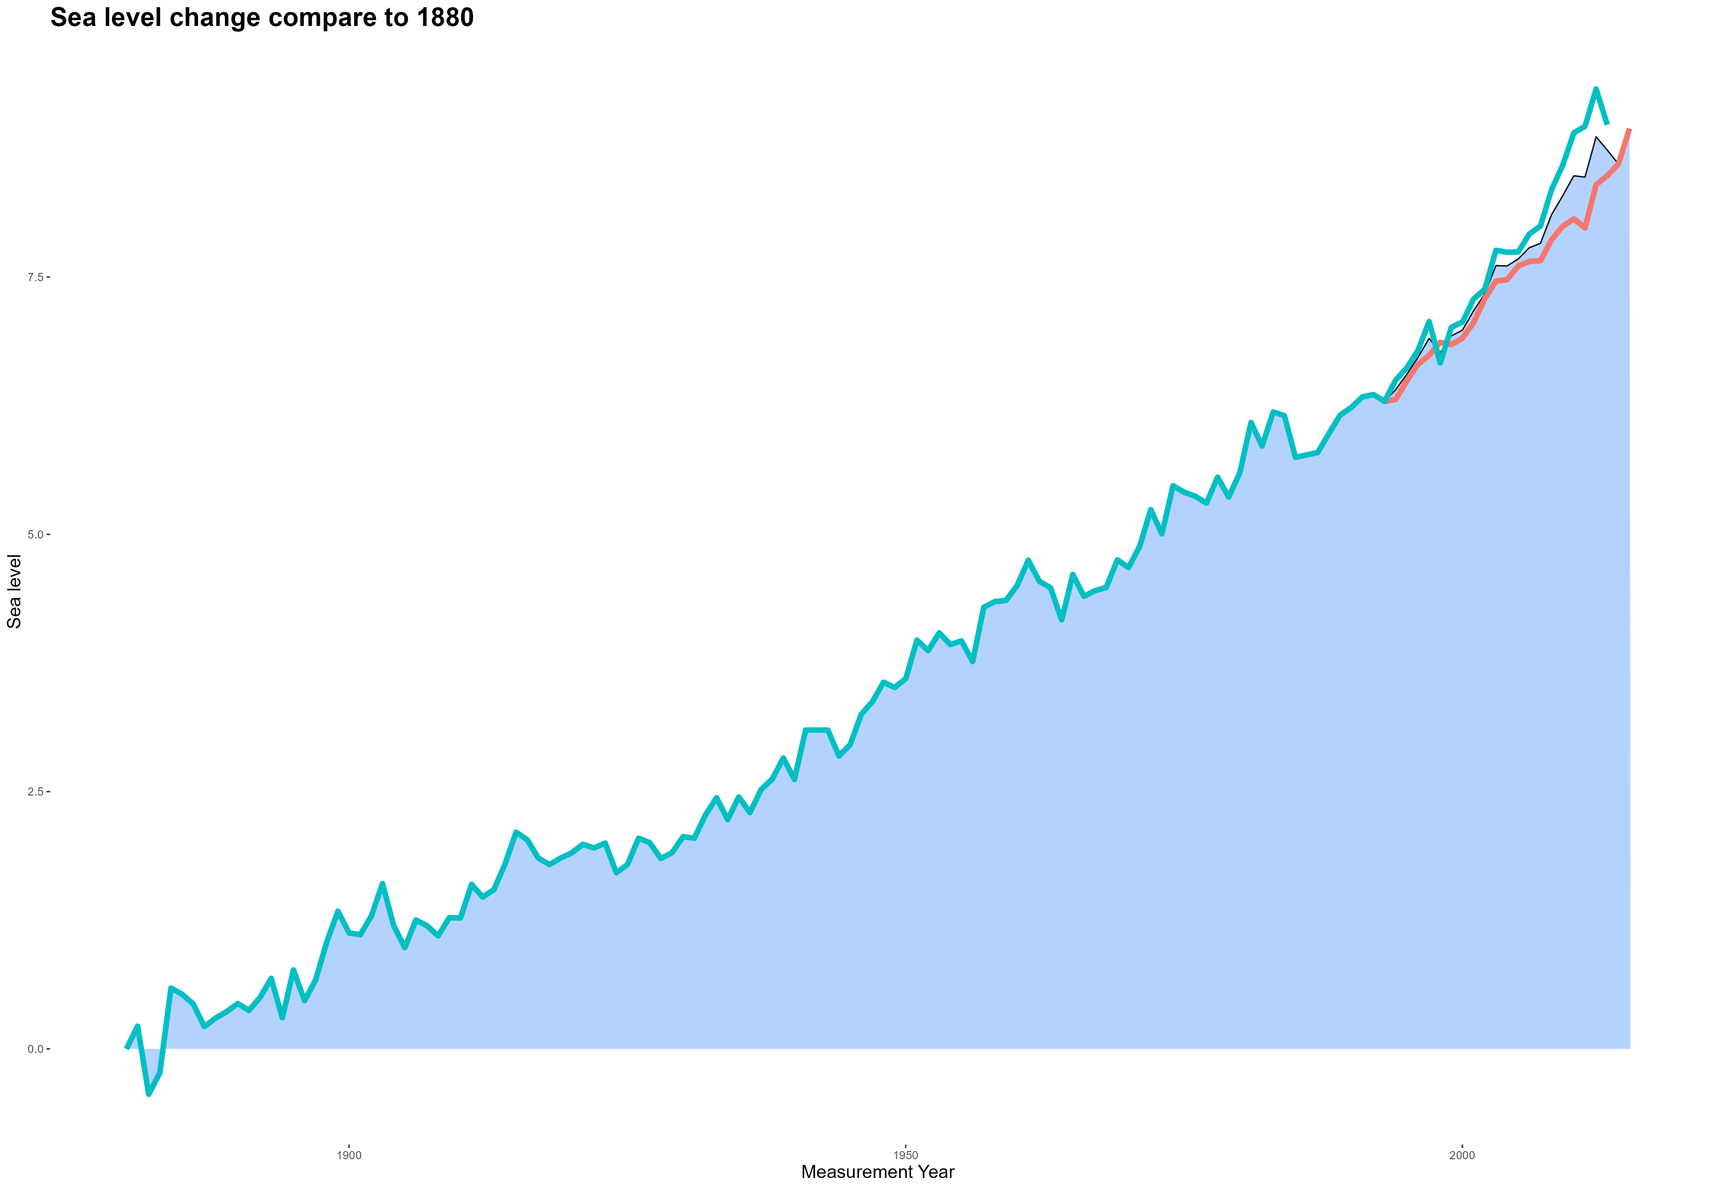
Sea level change: 1850 to nowadays
25 см
0 см
1850
2015
Green line – data from NOAA
Red line – data from CSIRO

Slide 6

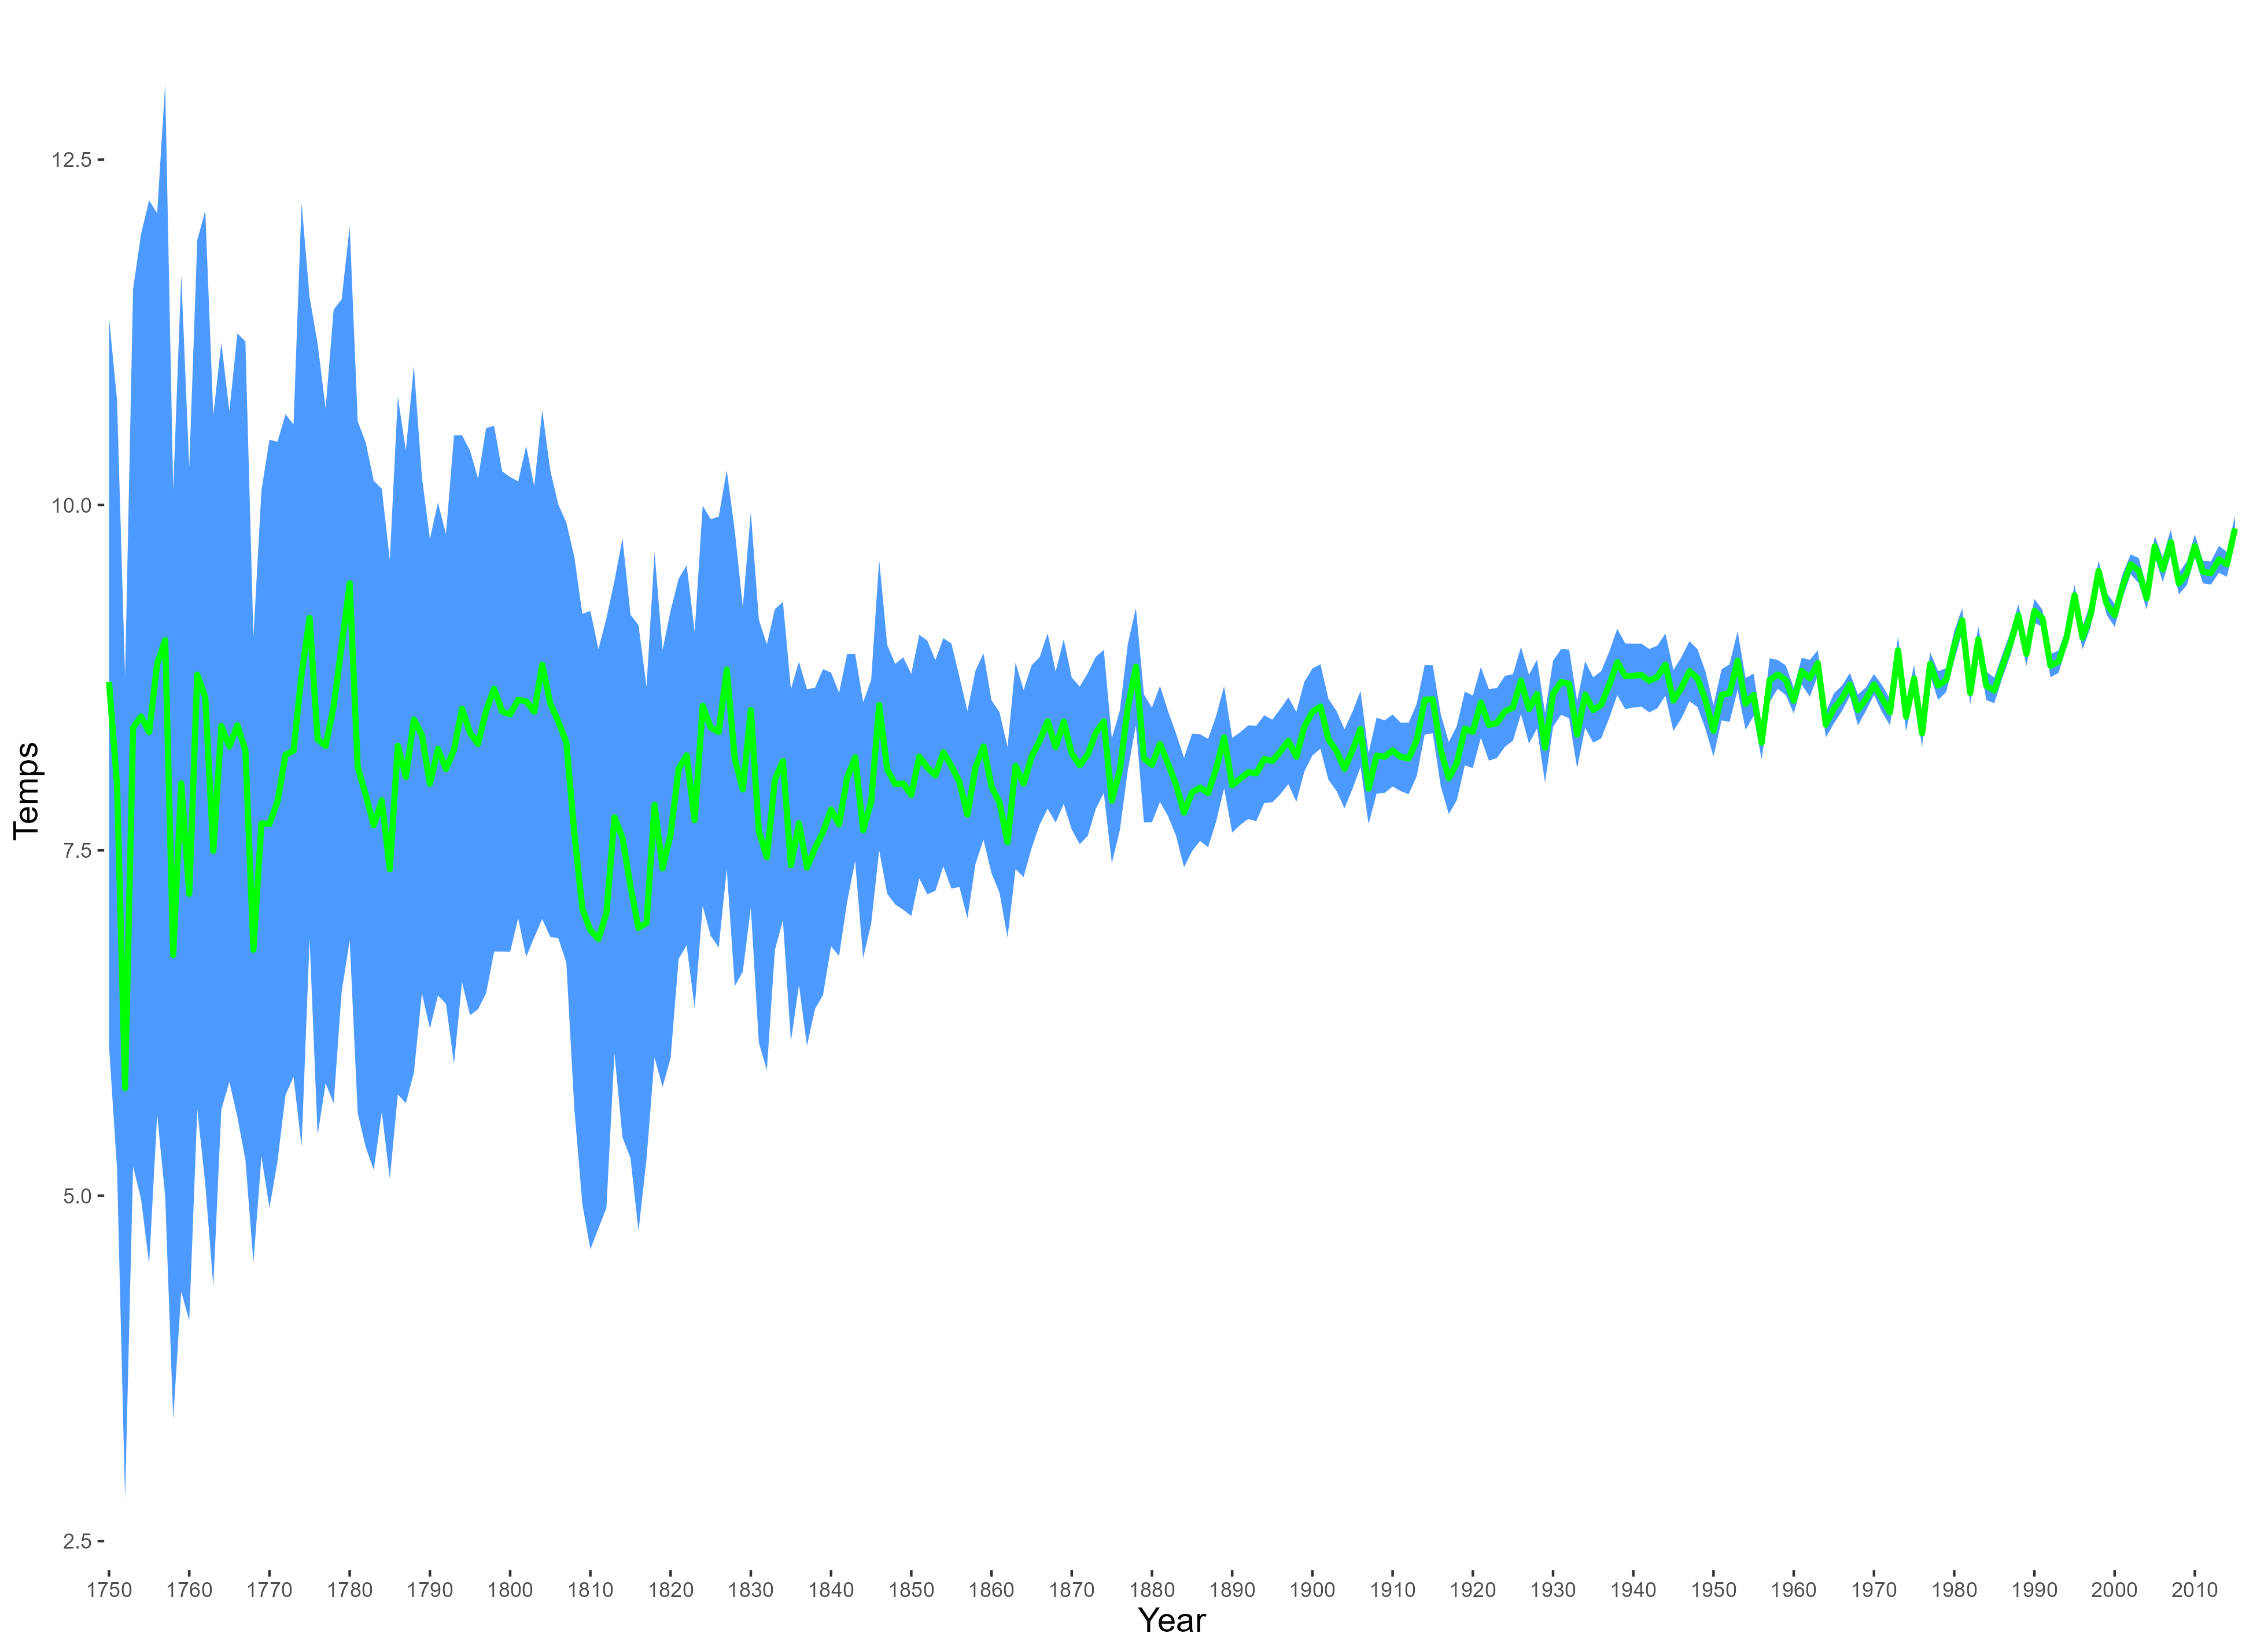
Sea level change: 1850 to nowadays
12.5 ℃
Temperature change: 1880 to nowadays
2.5 ℃
1880
2014
Green line – temperature change
Blue area – possible temperature spread due to inaccurate measurements

Slide 7

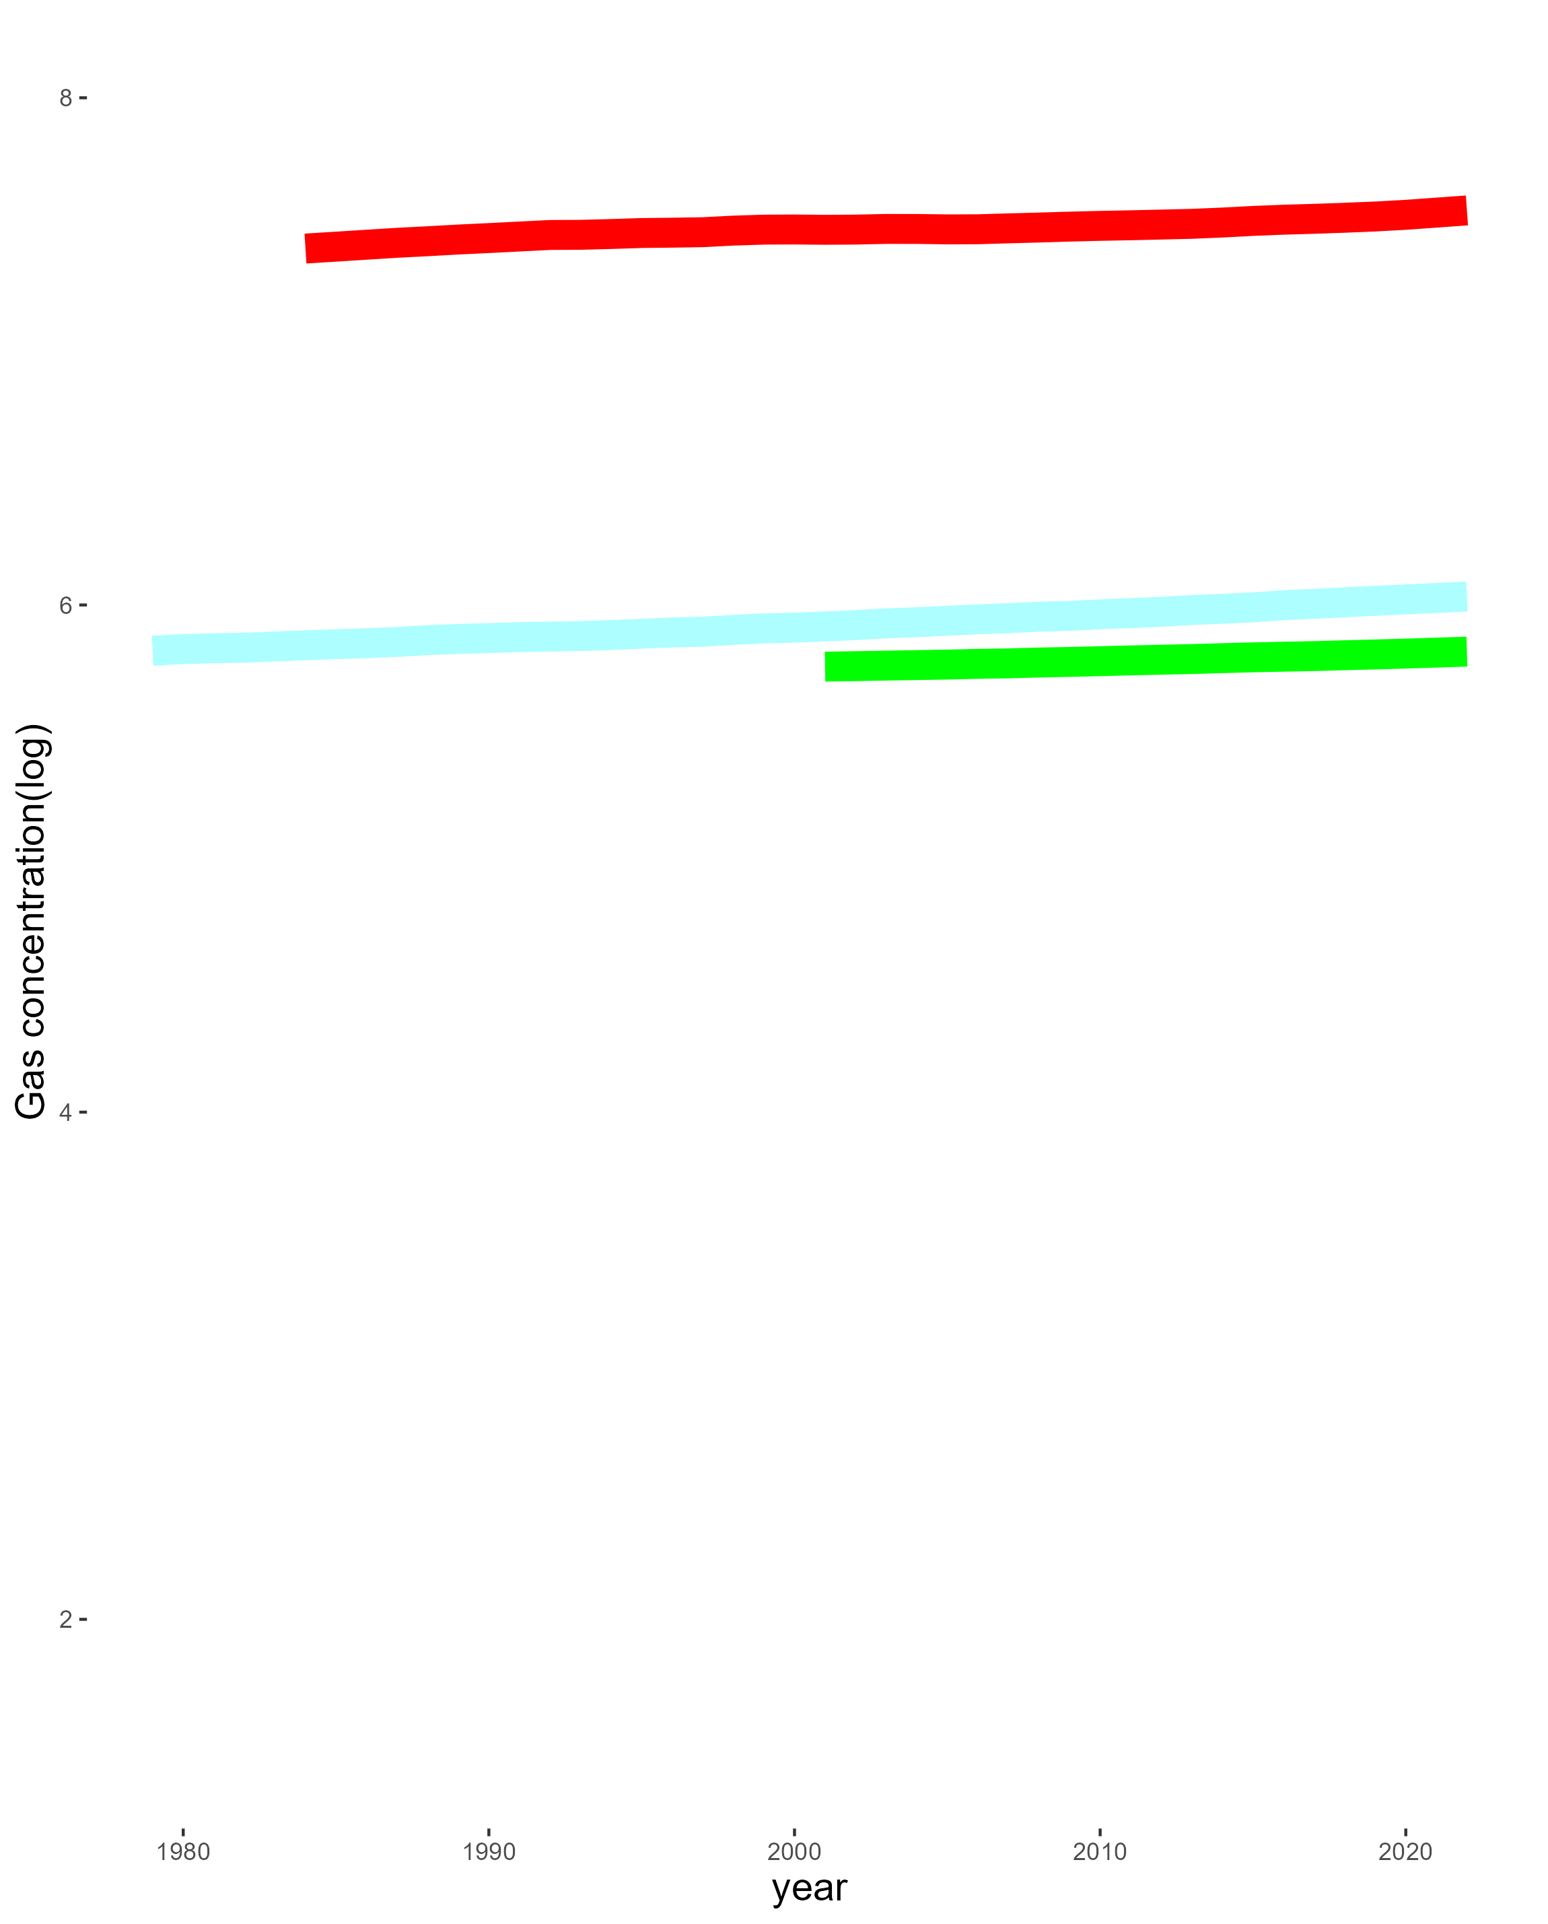
CH4
6*10^12 kg
CO2
N2O
Gases Stats
SF6
2*10^12 kg
1990
2015
The graph illustrates a slow increase in the concentration of harmful gases in the atmosphere (last 20 years)

Slide 8
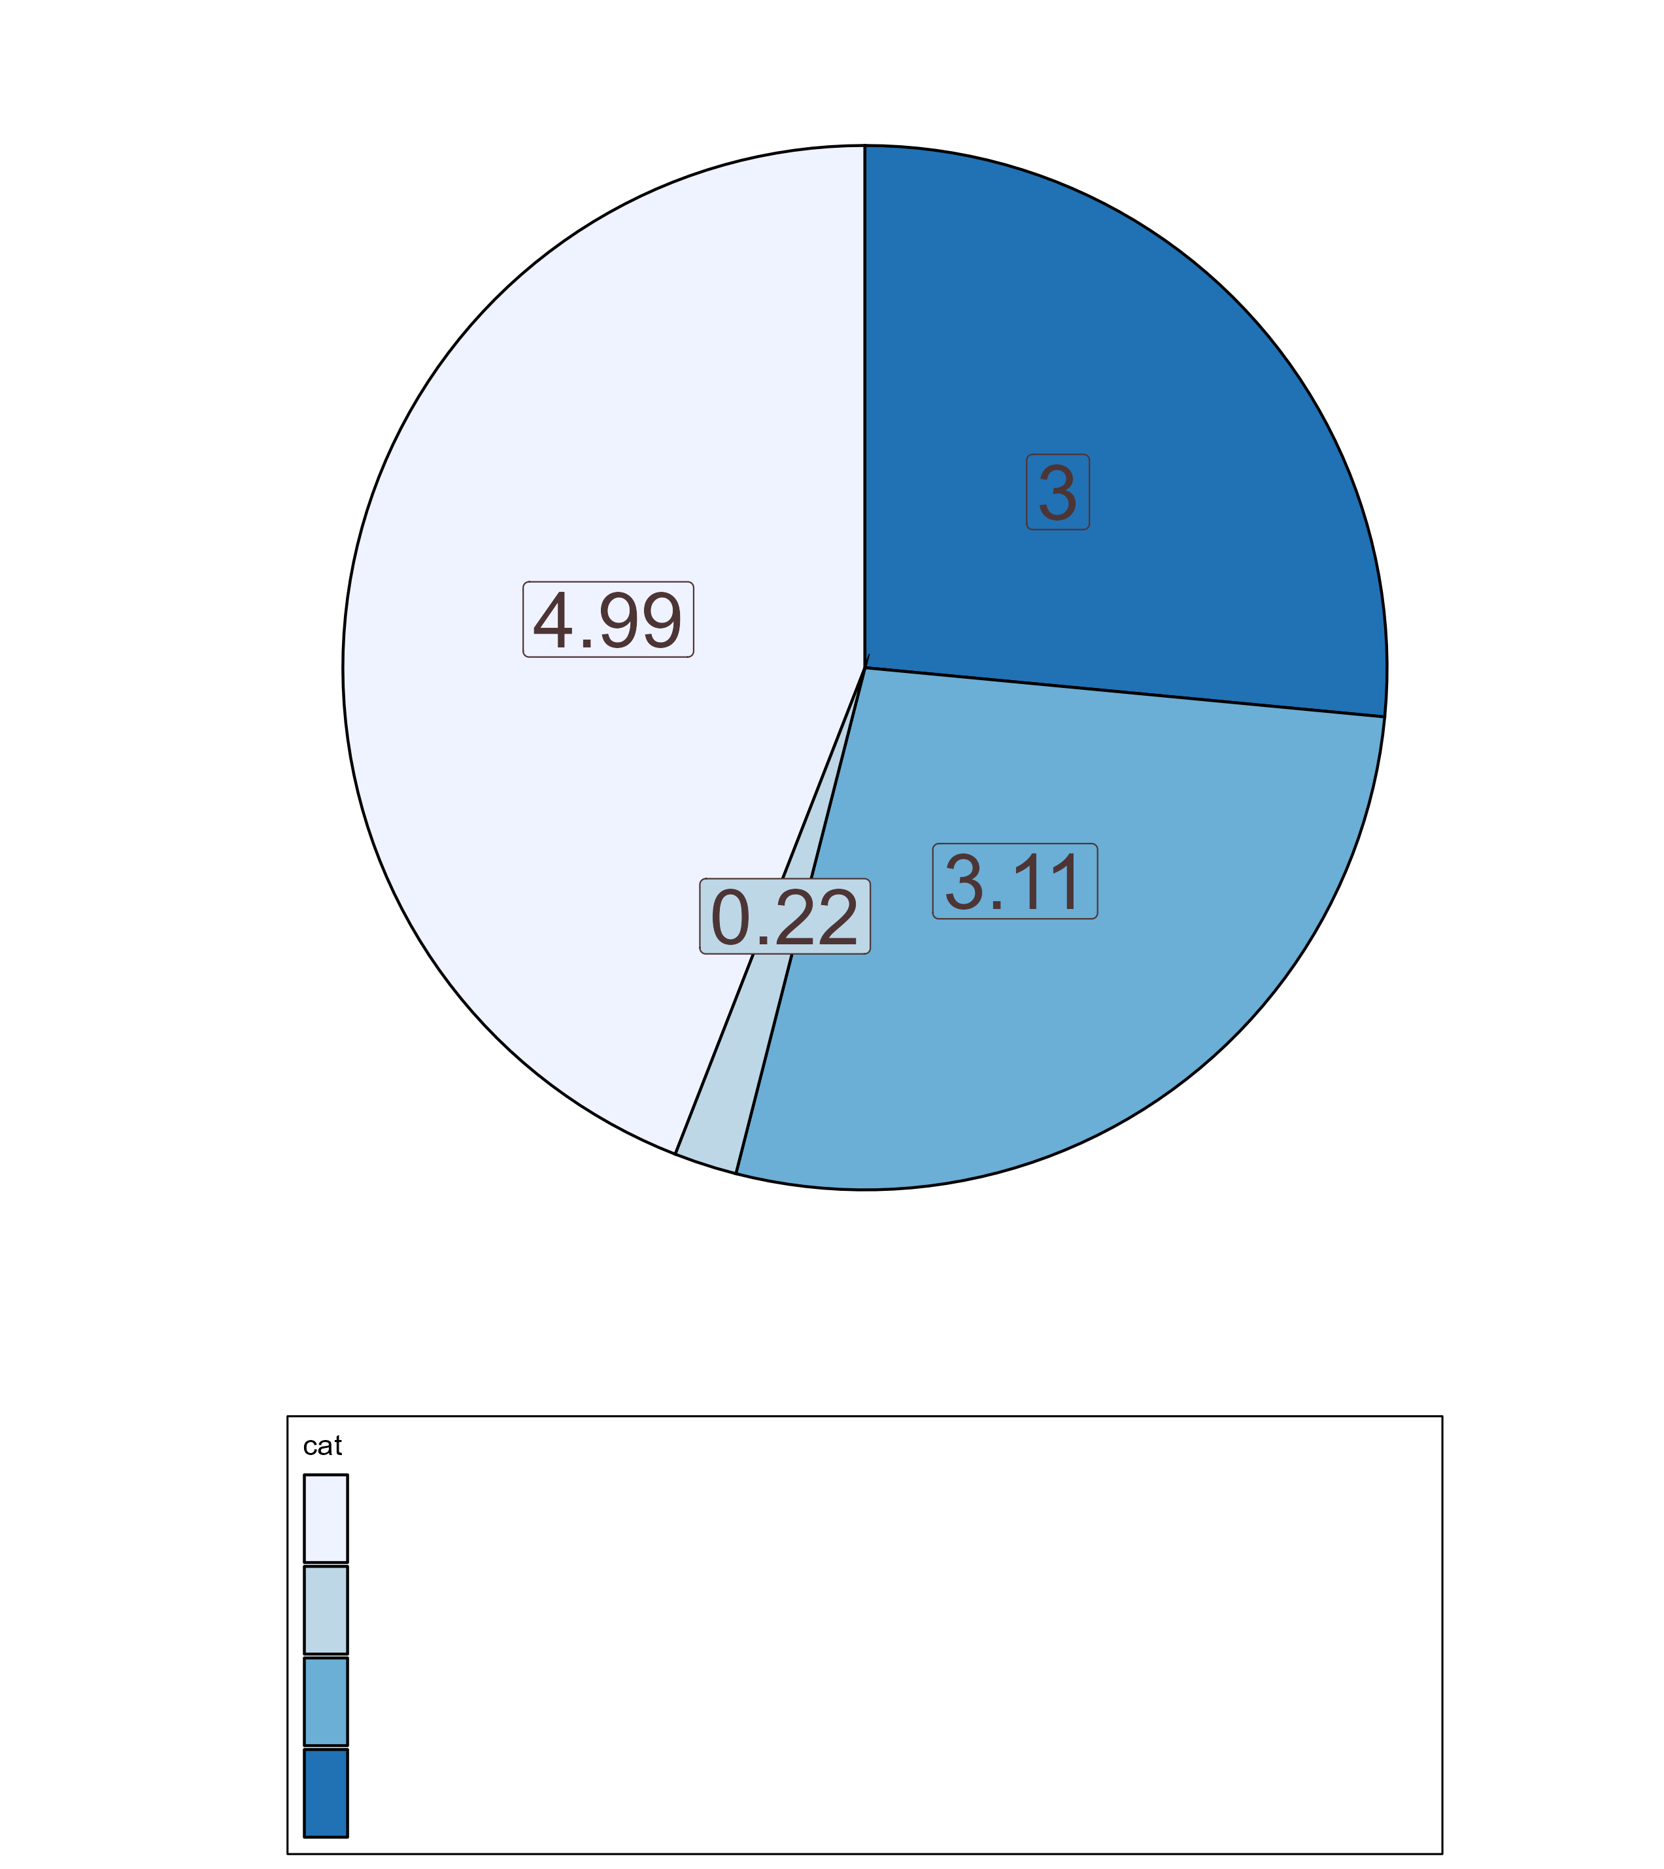
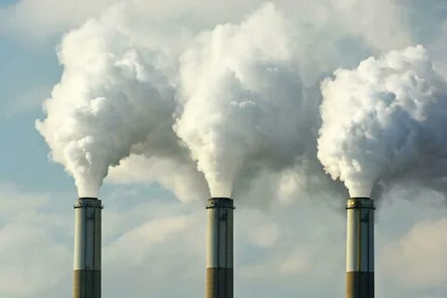
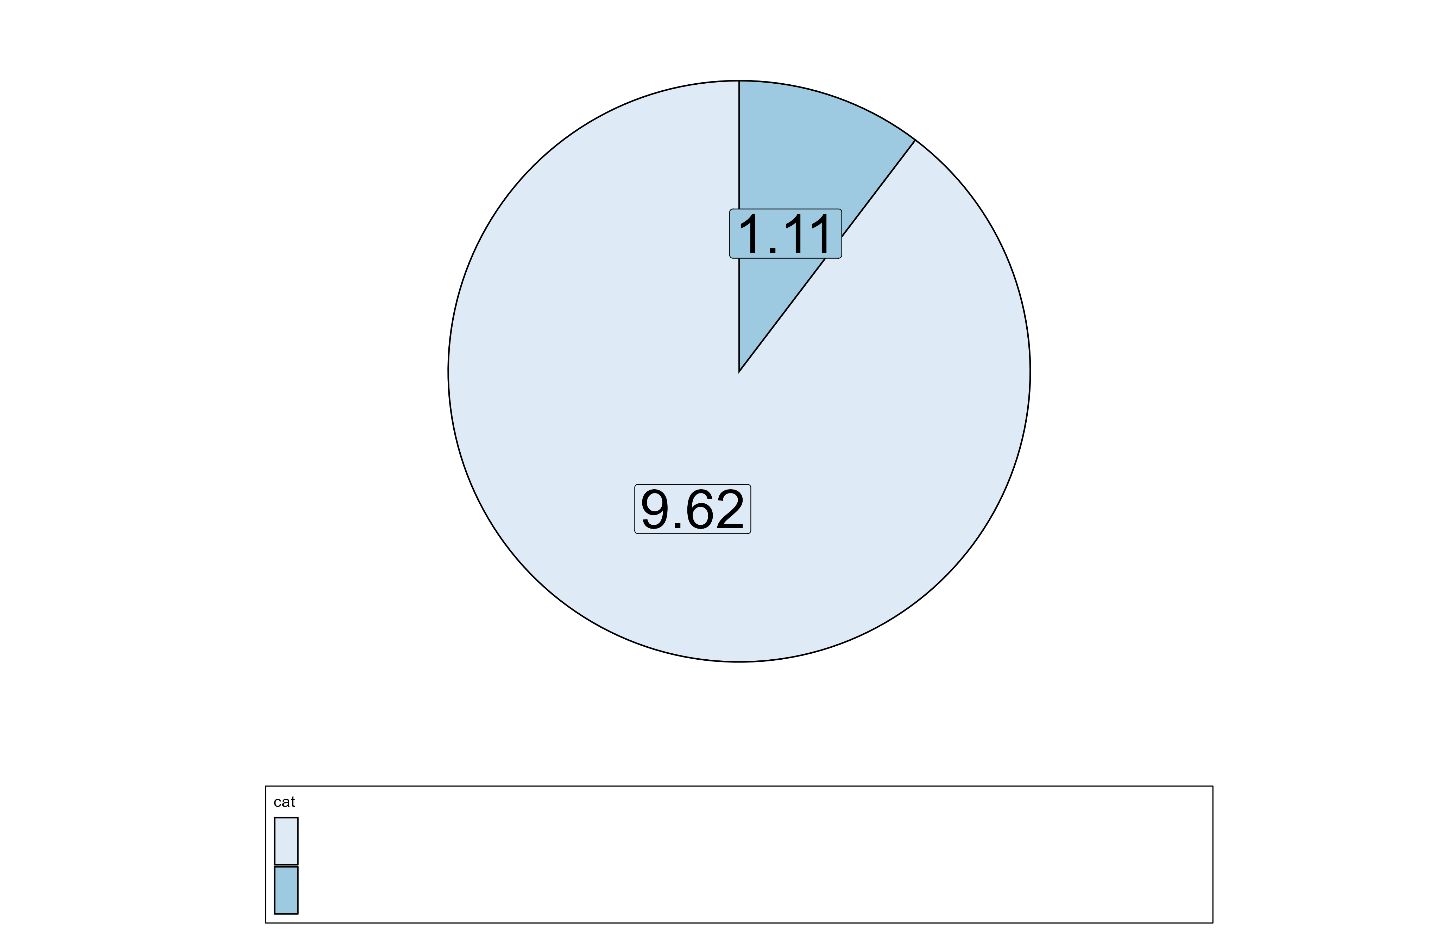
CO2 Emissions

Slide 9
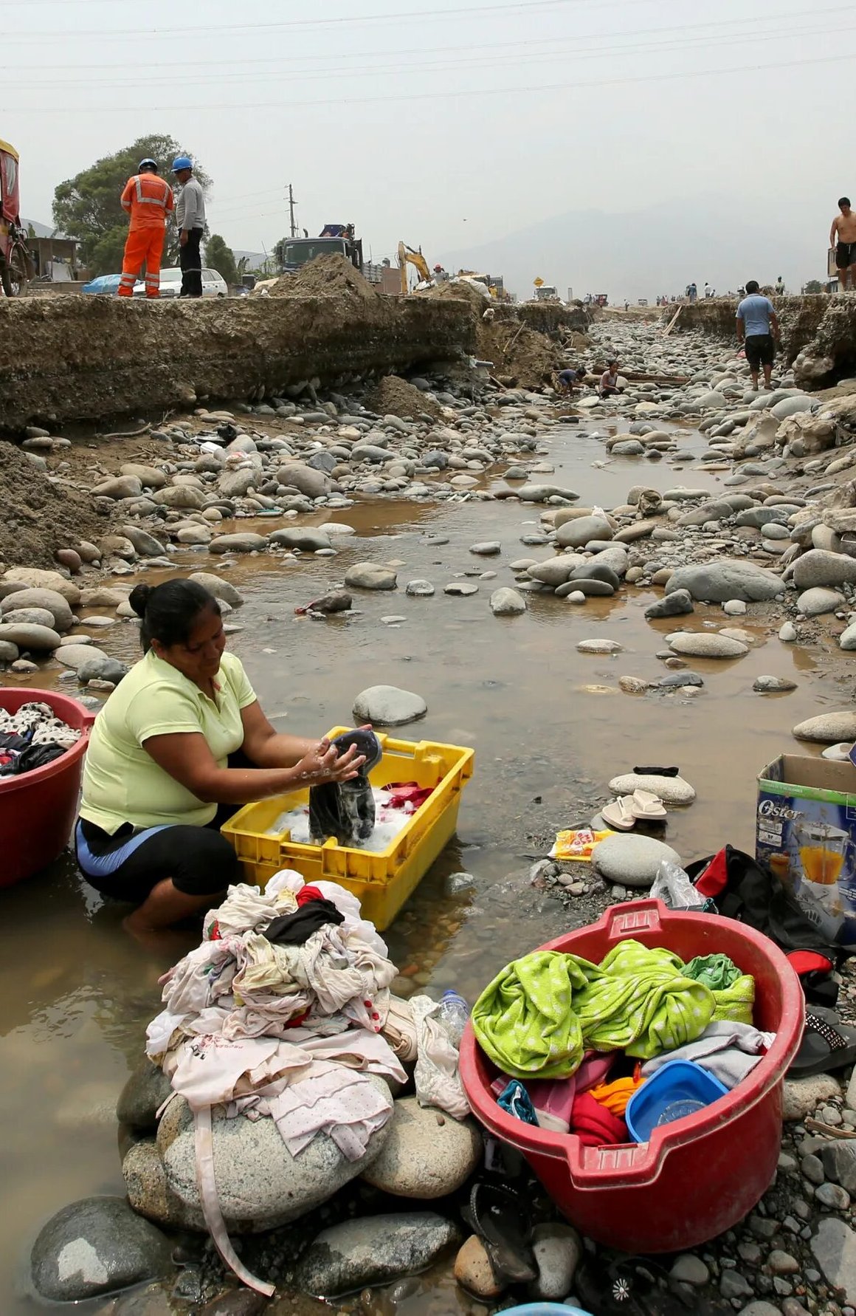
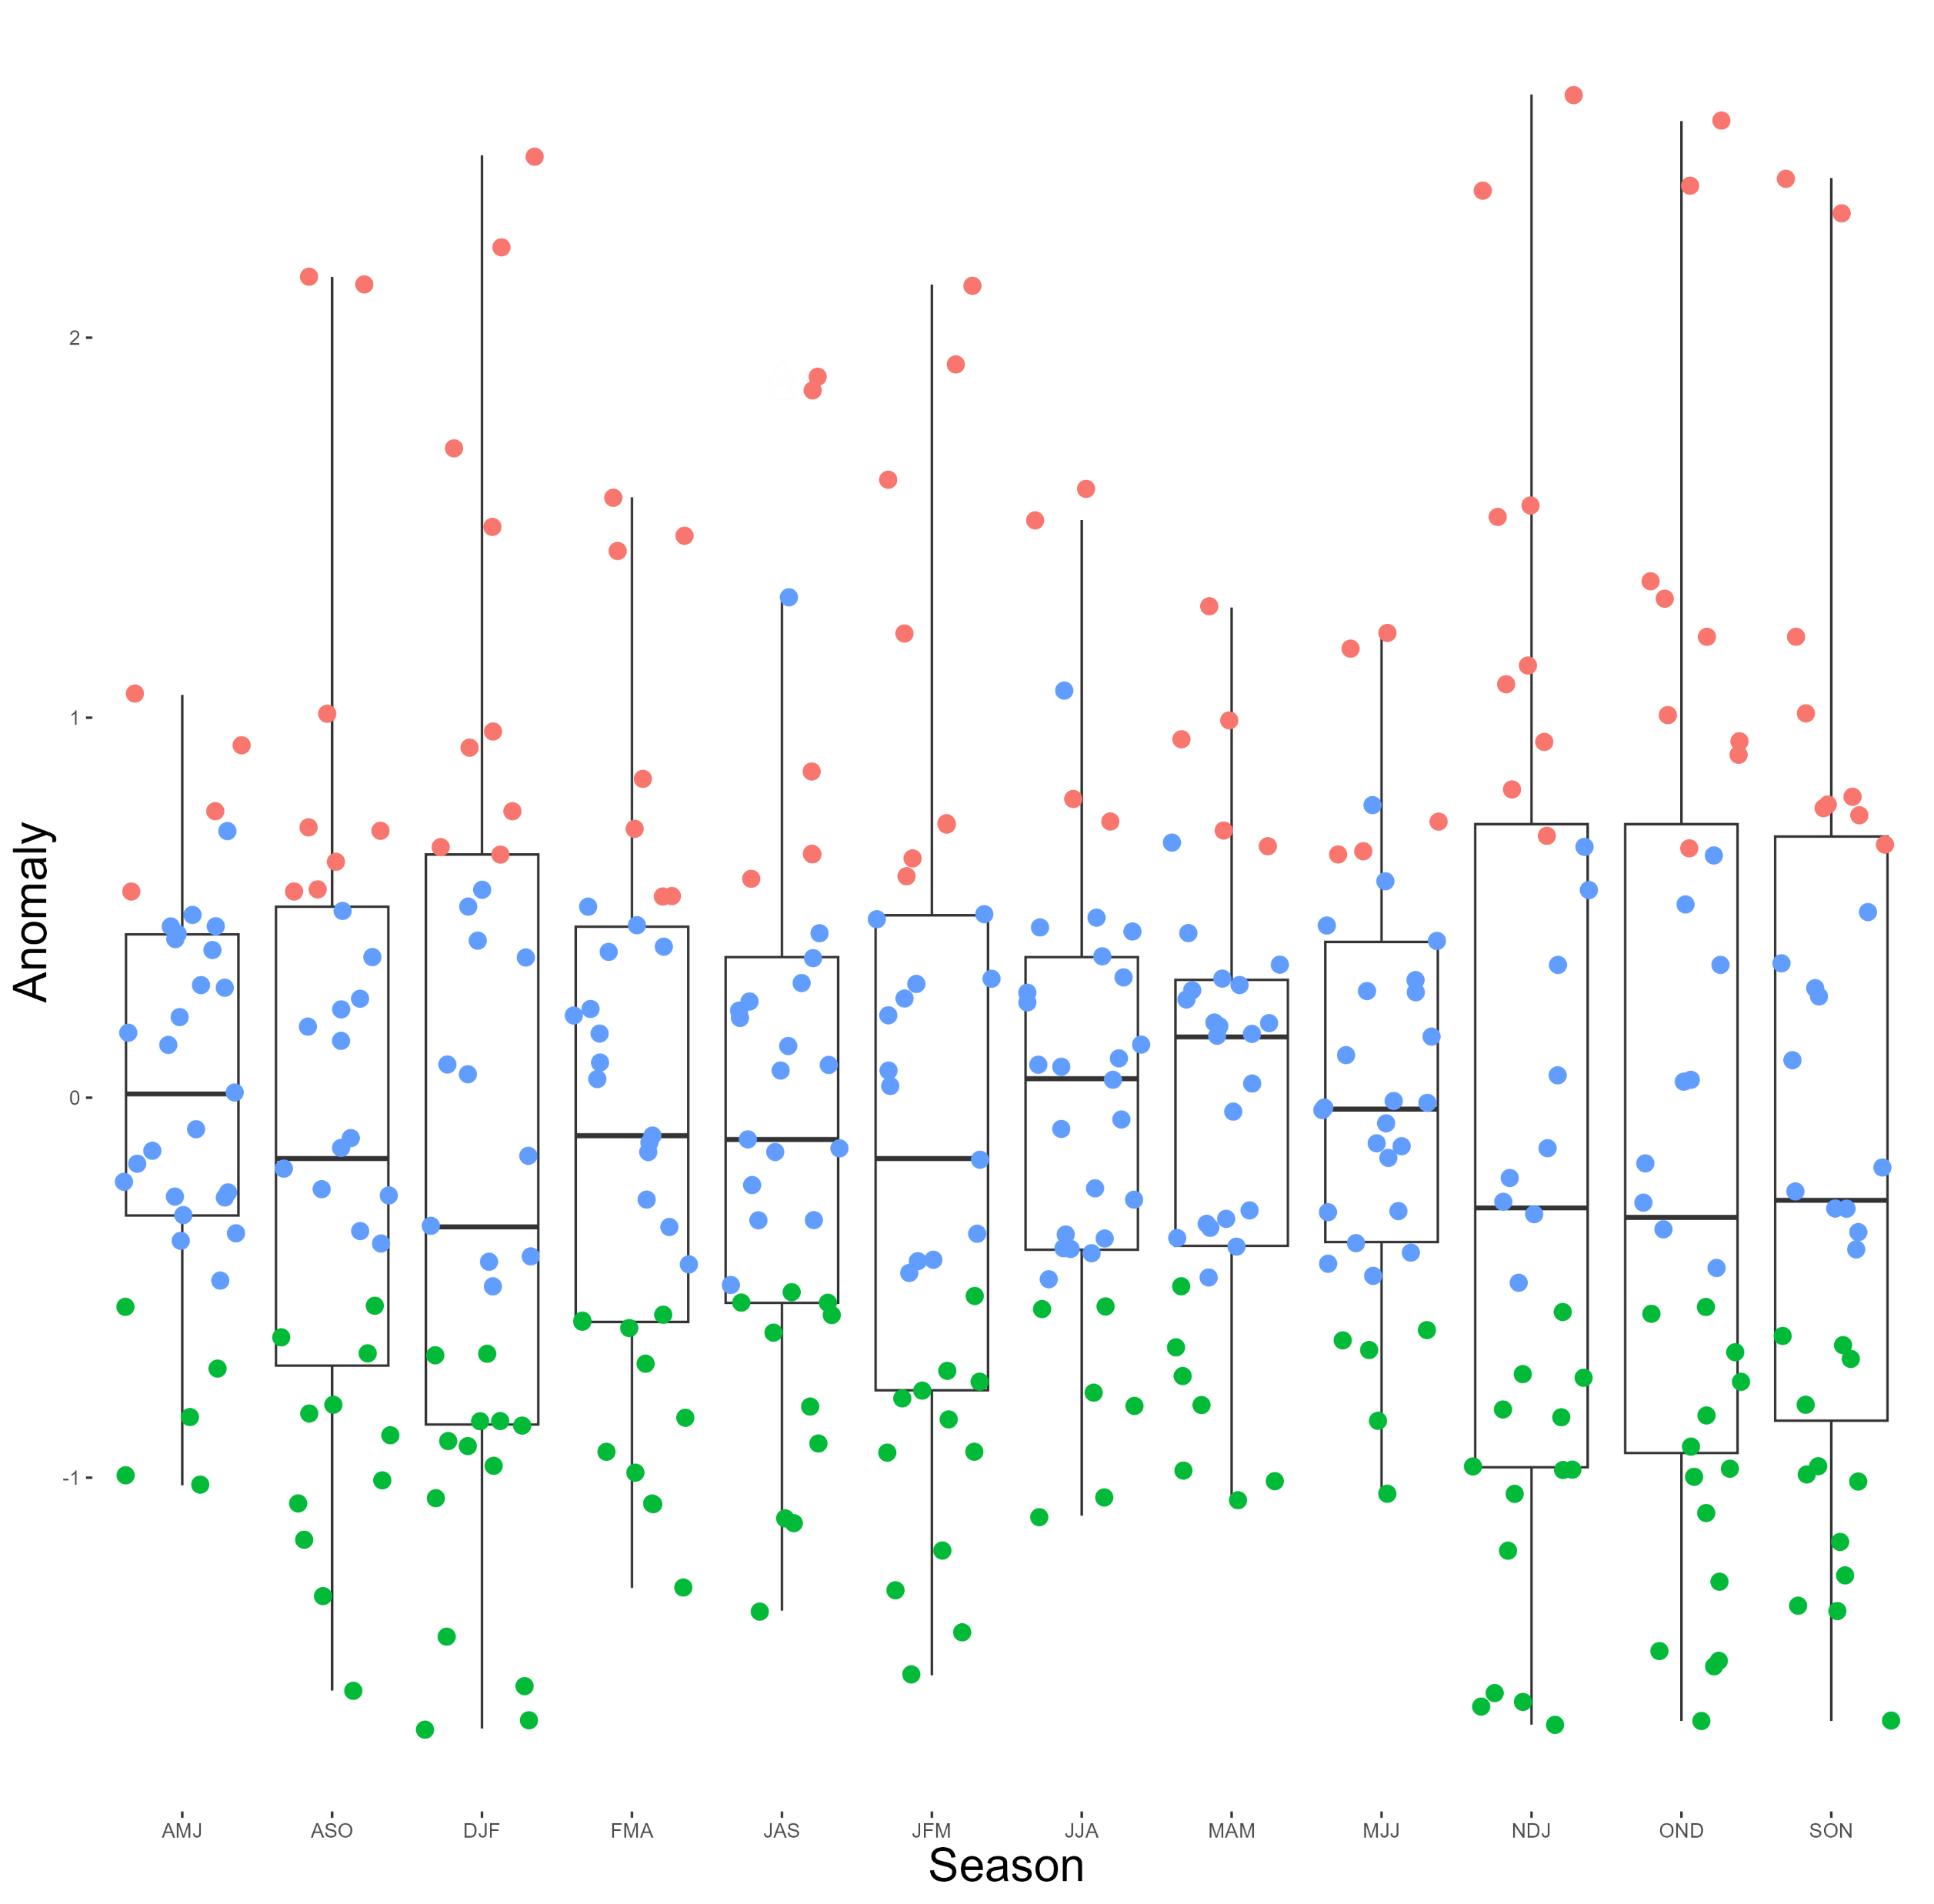
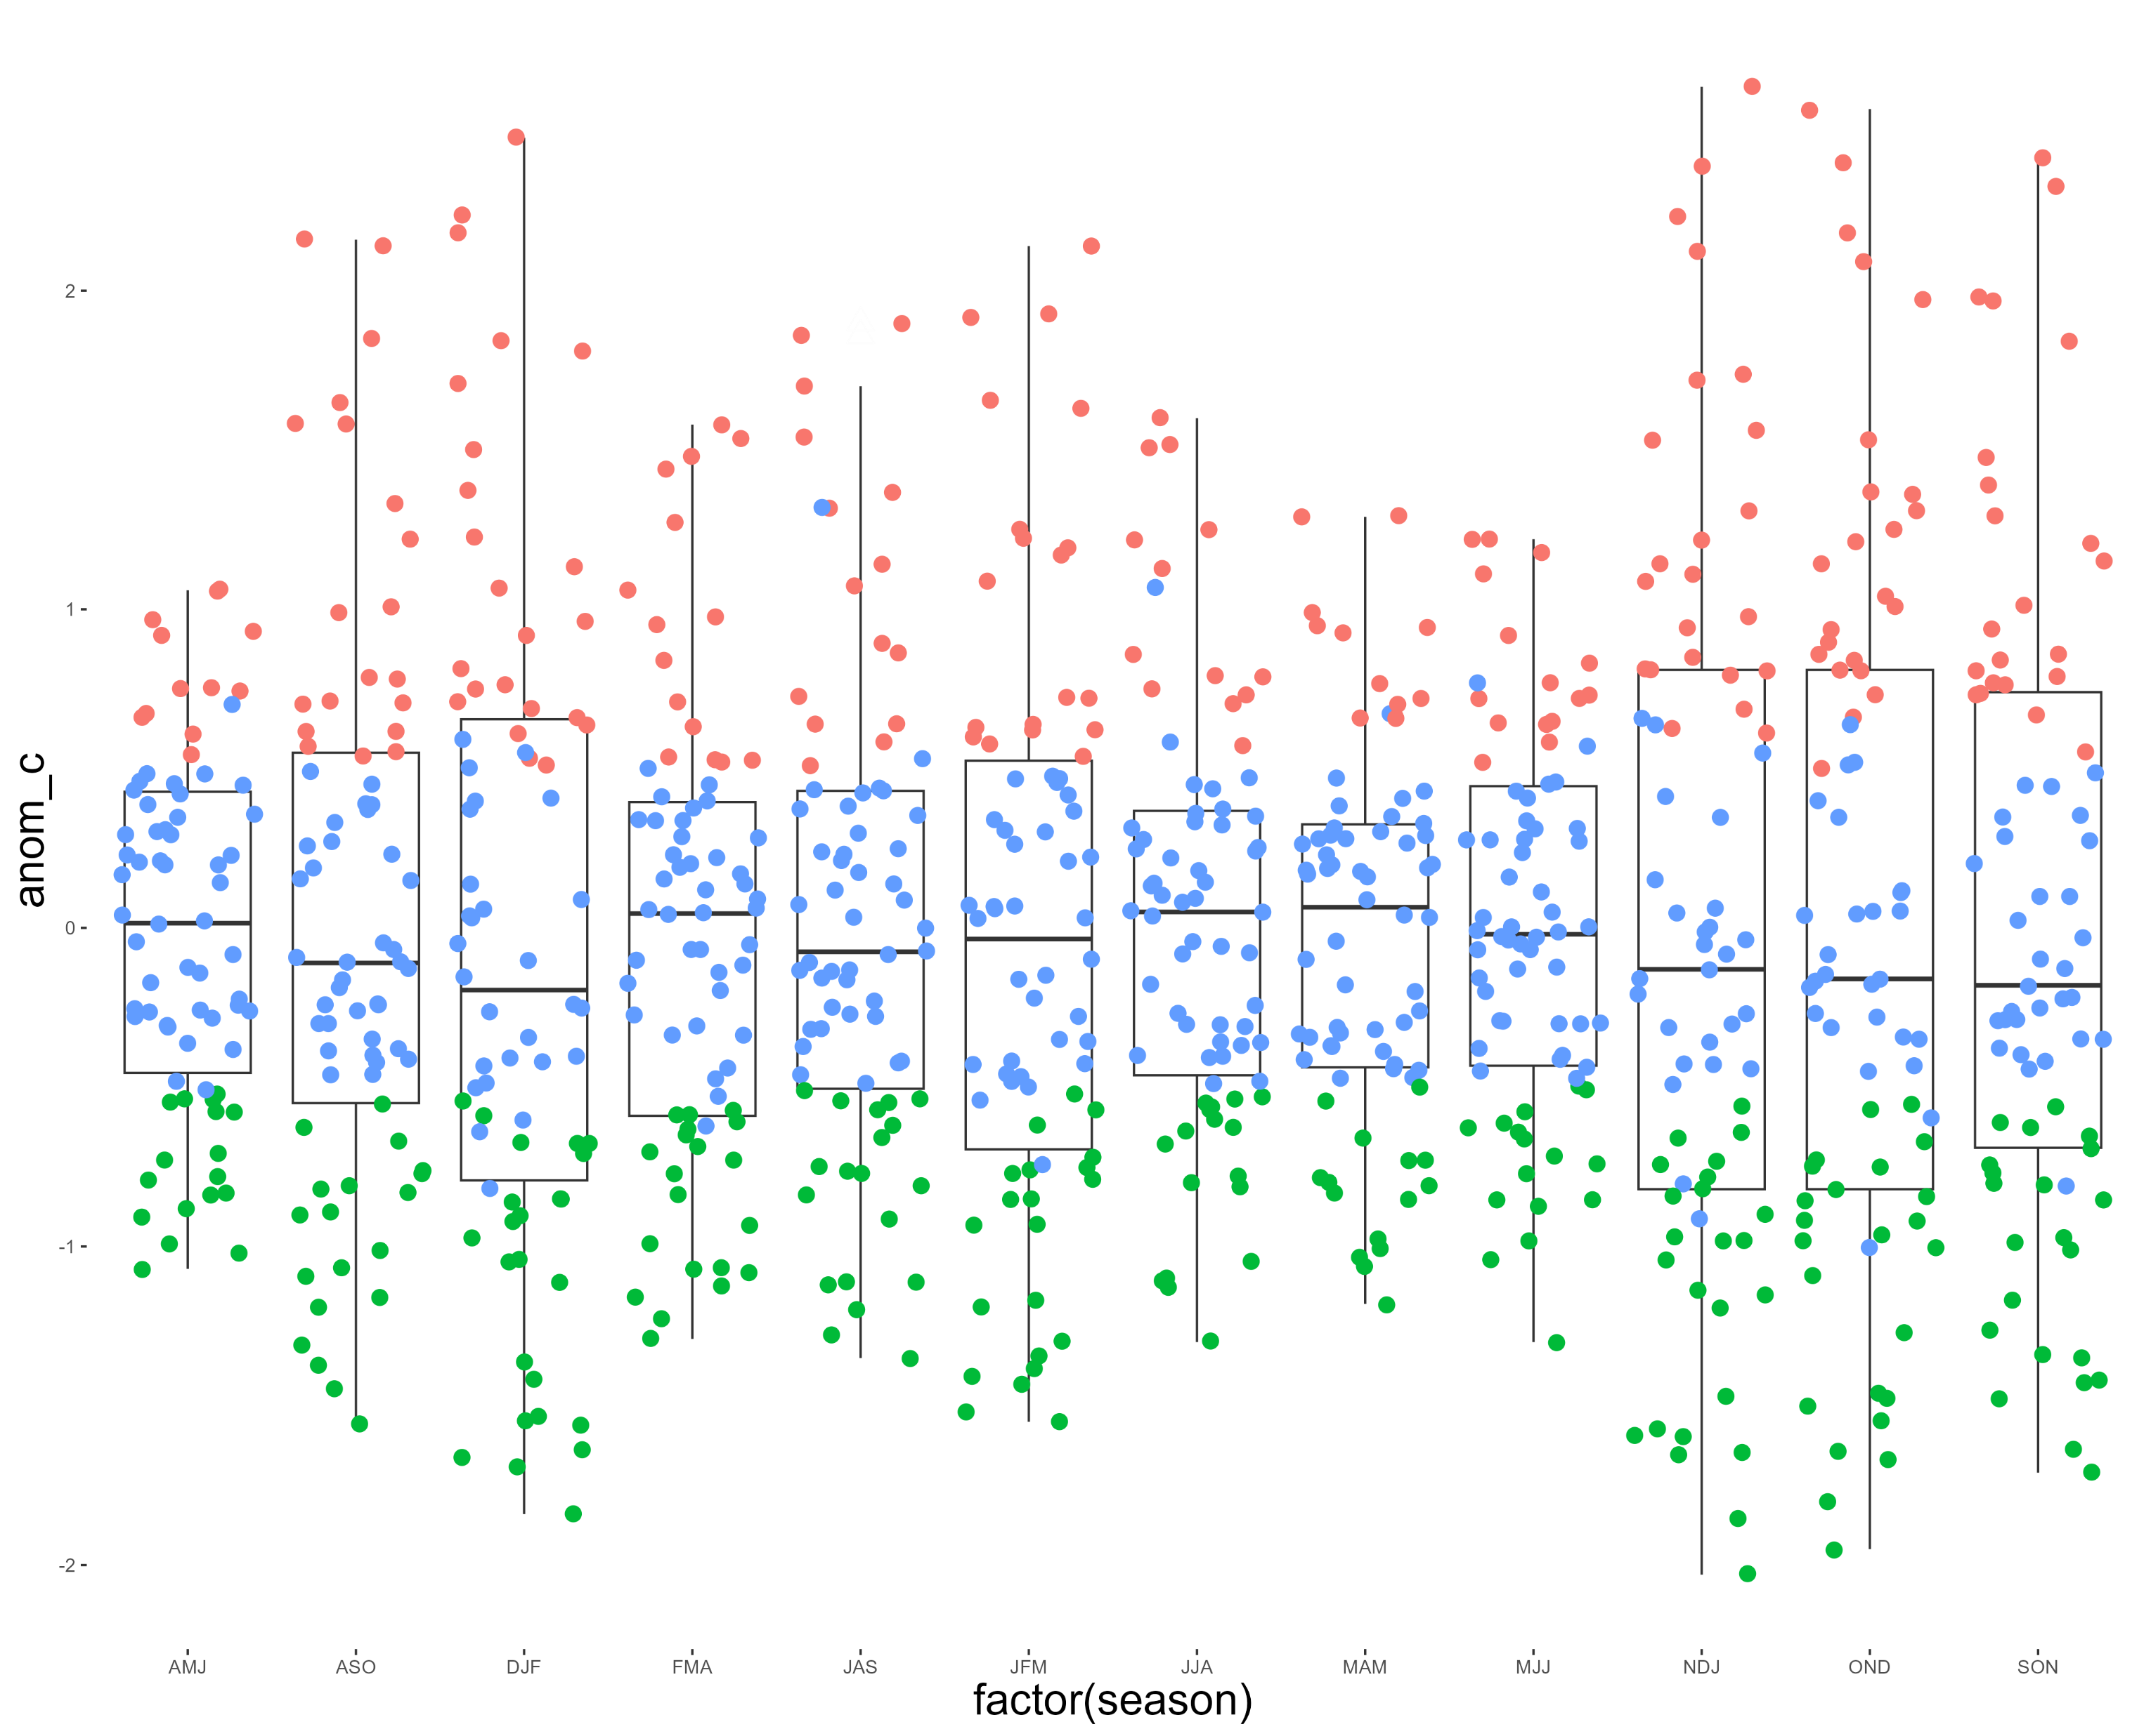
EL-NINO PHENOMENON
All time
Since 1990
2
0
-1
AMJ
SON
Green dots – la-nina
Blue dots – neutral
Red dots – el-nino

Slide 10
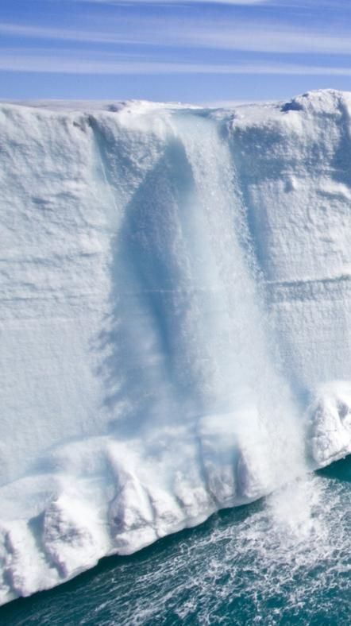
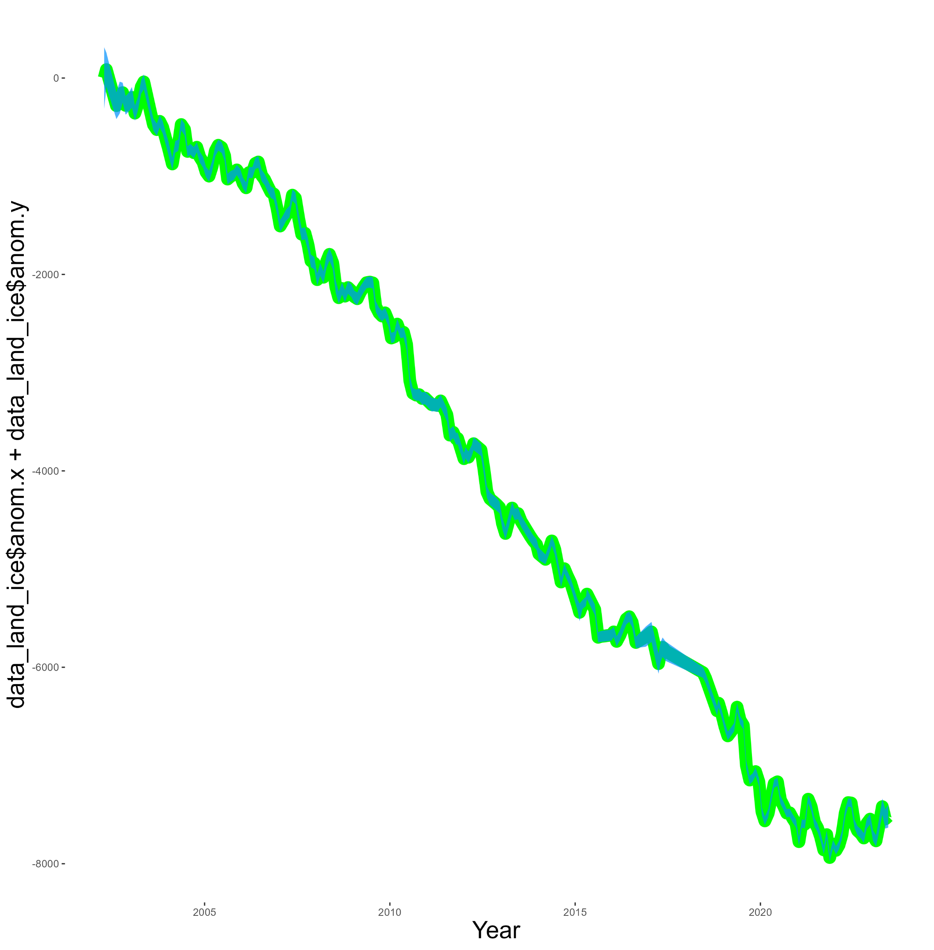
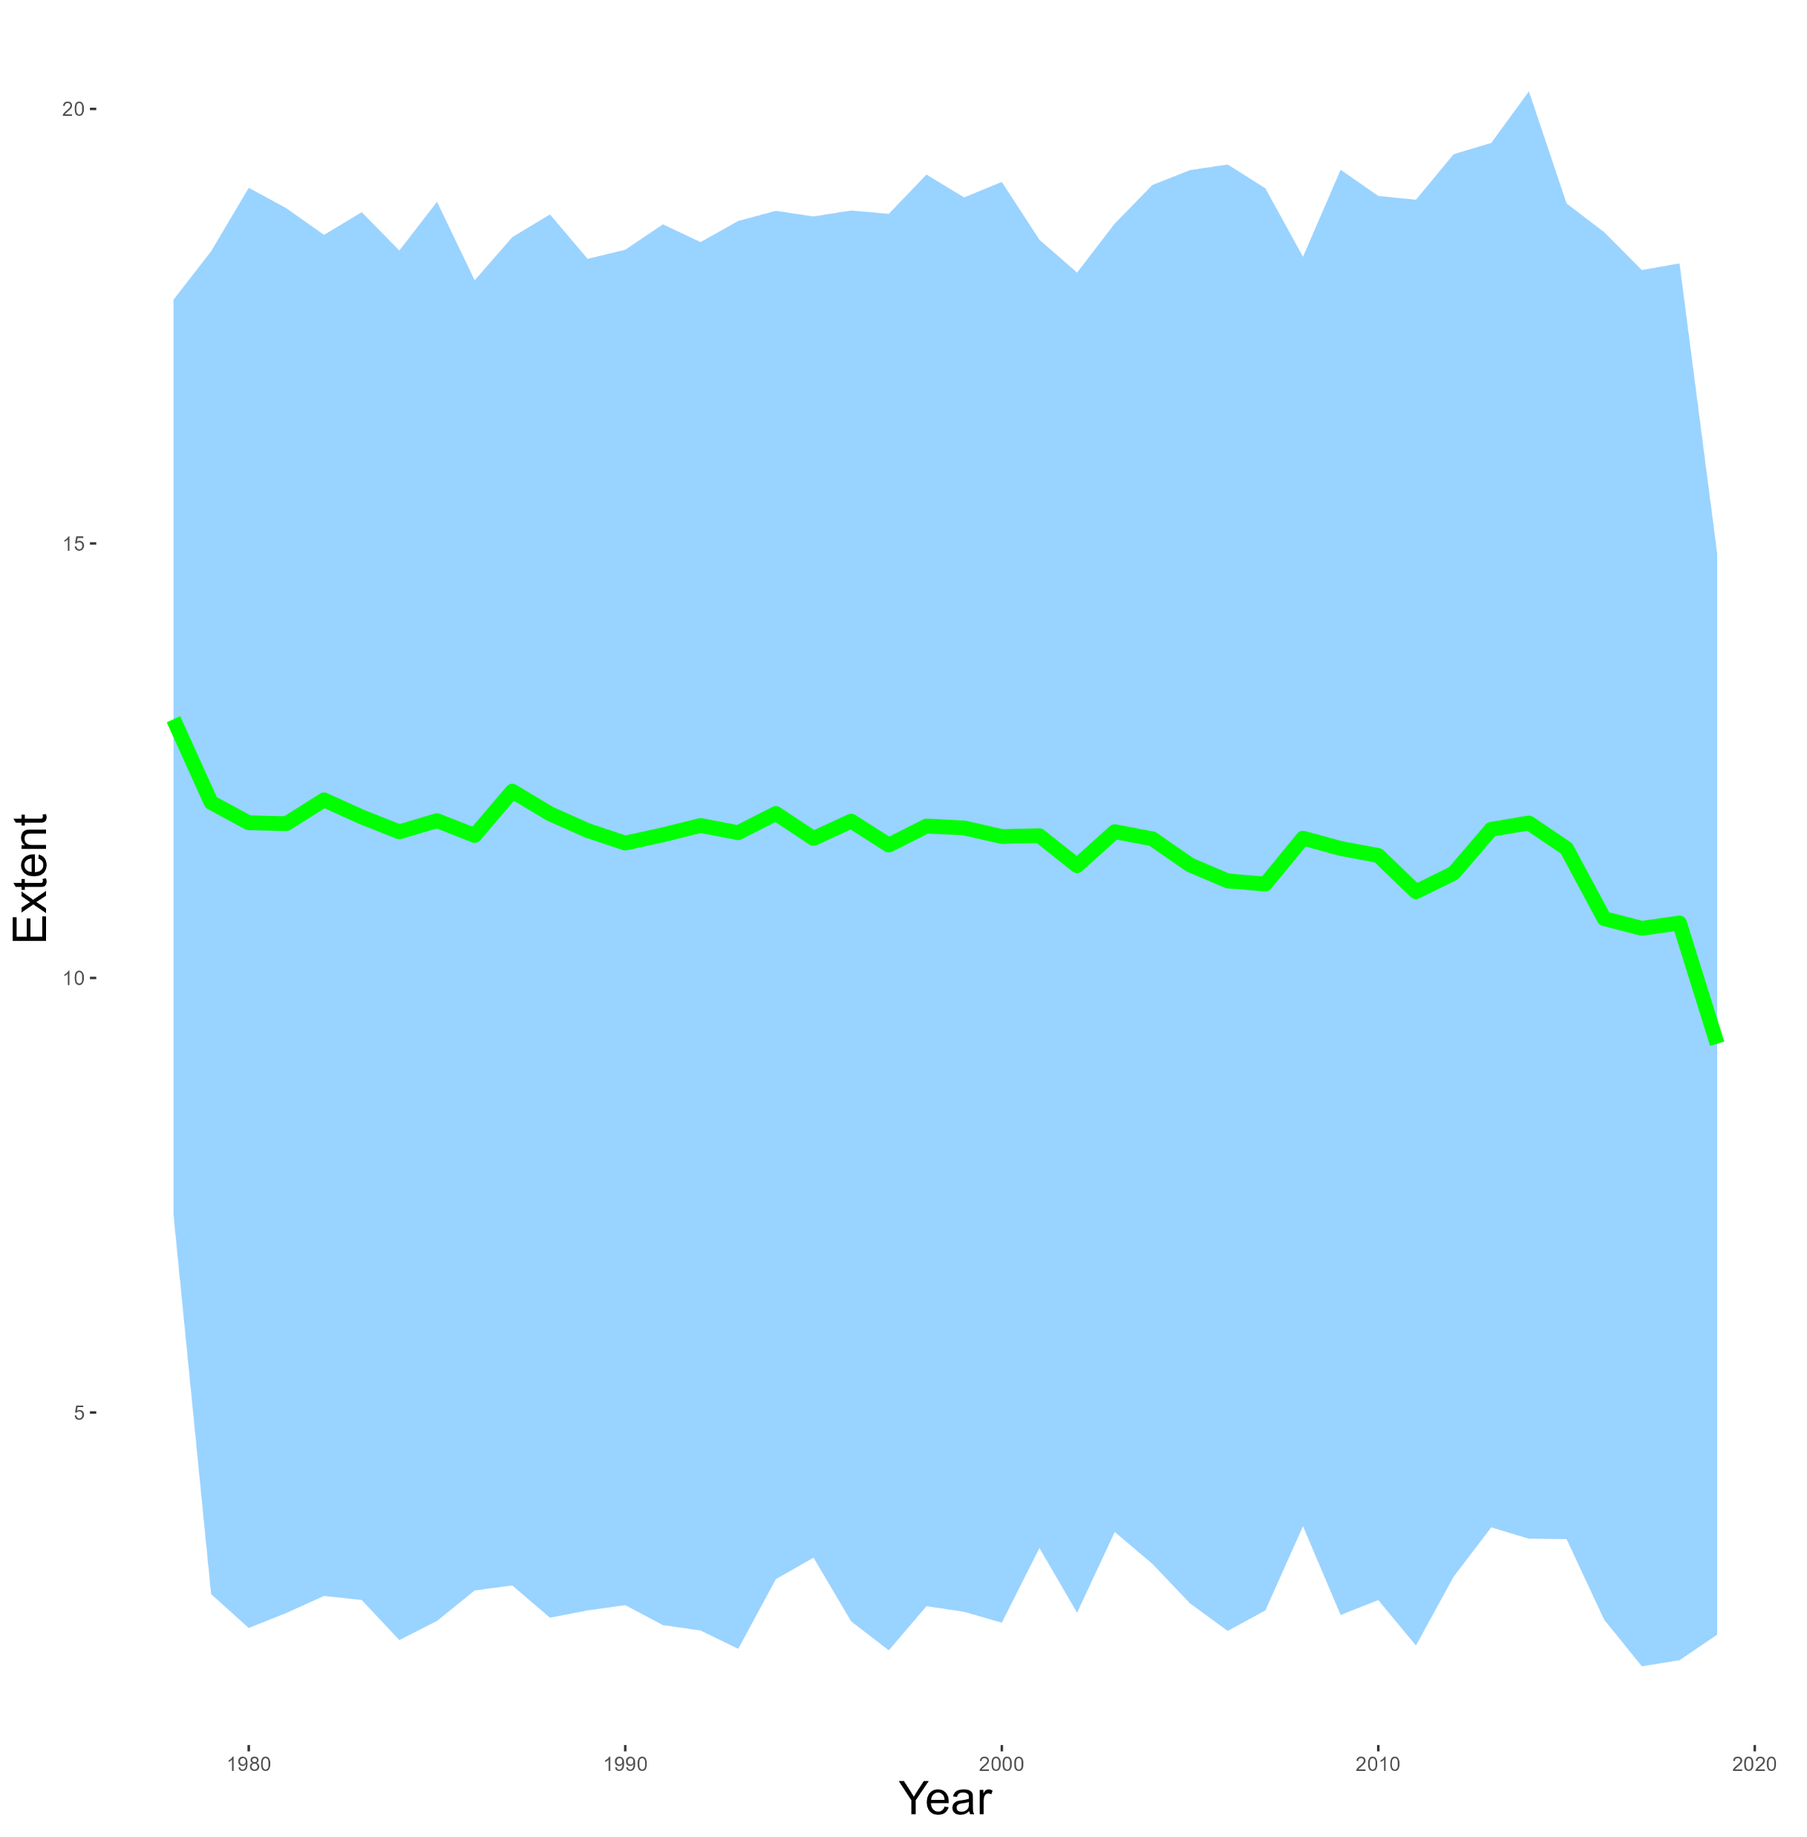
ICE DATA
0
Land Ice Mass
20
-6000
2002
2023
Sea Ice Extent
5
1979
2020

Slide 11
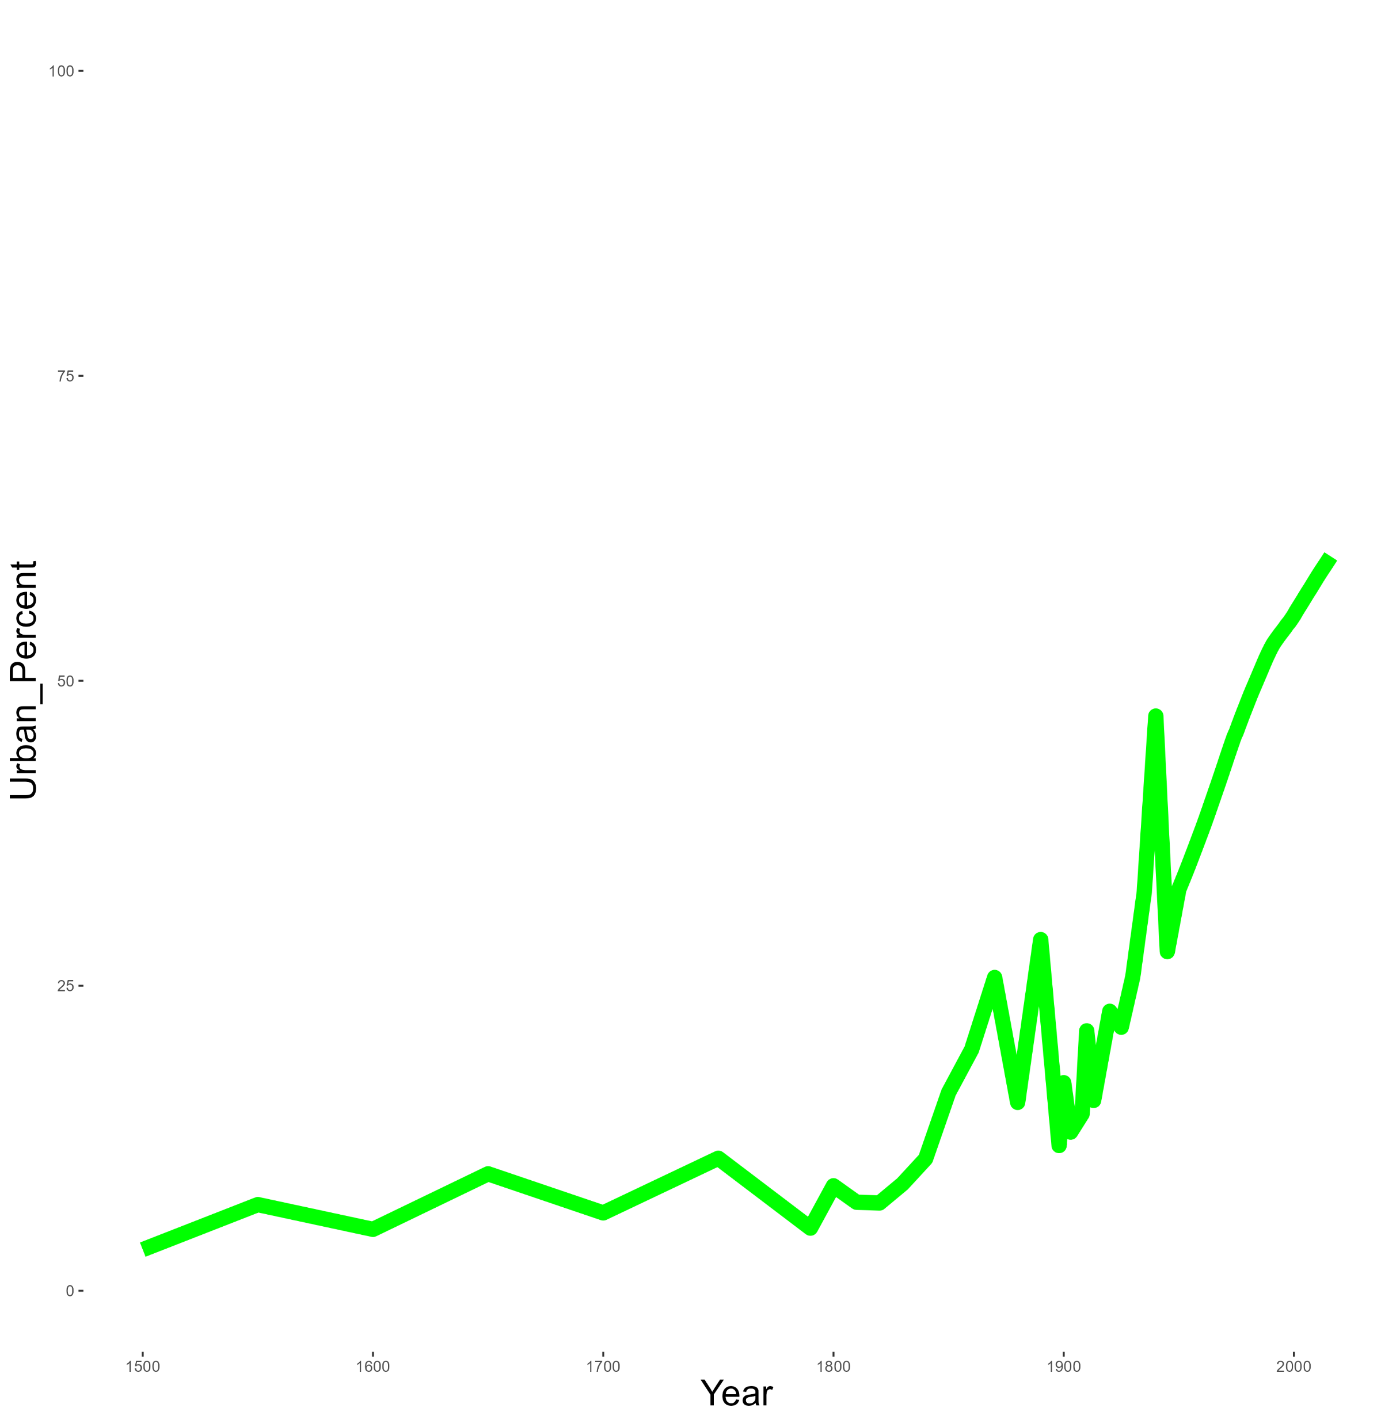

Urbanization
60%
0
1500
2016
Global urban population percentage grow

Slide 12

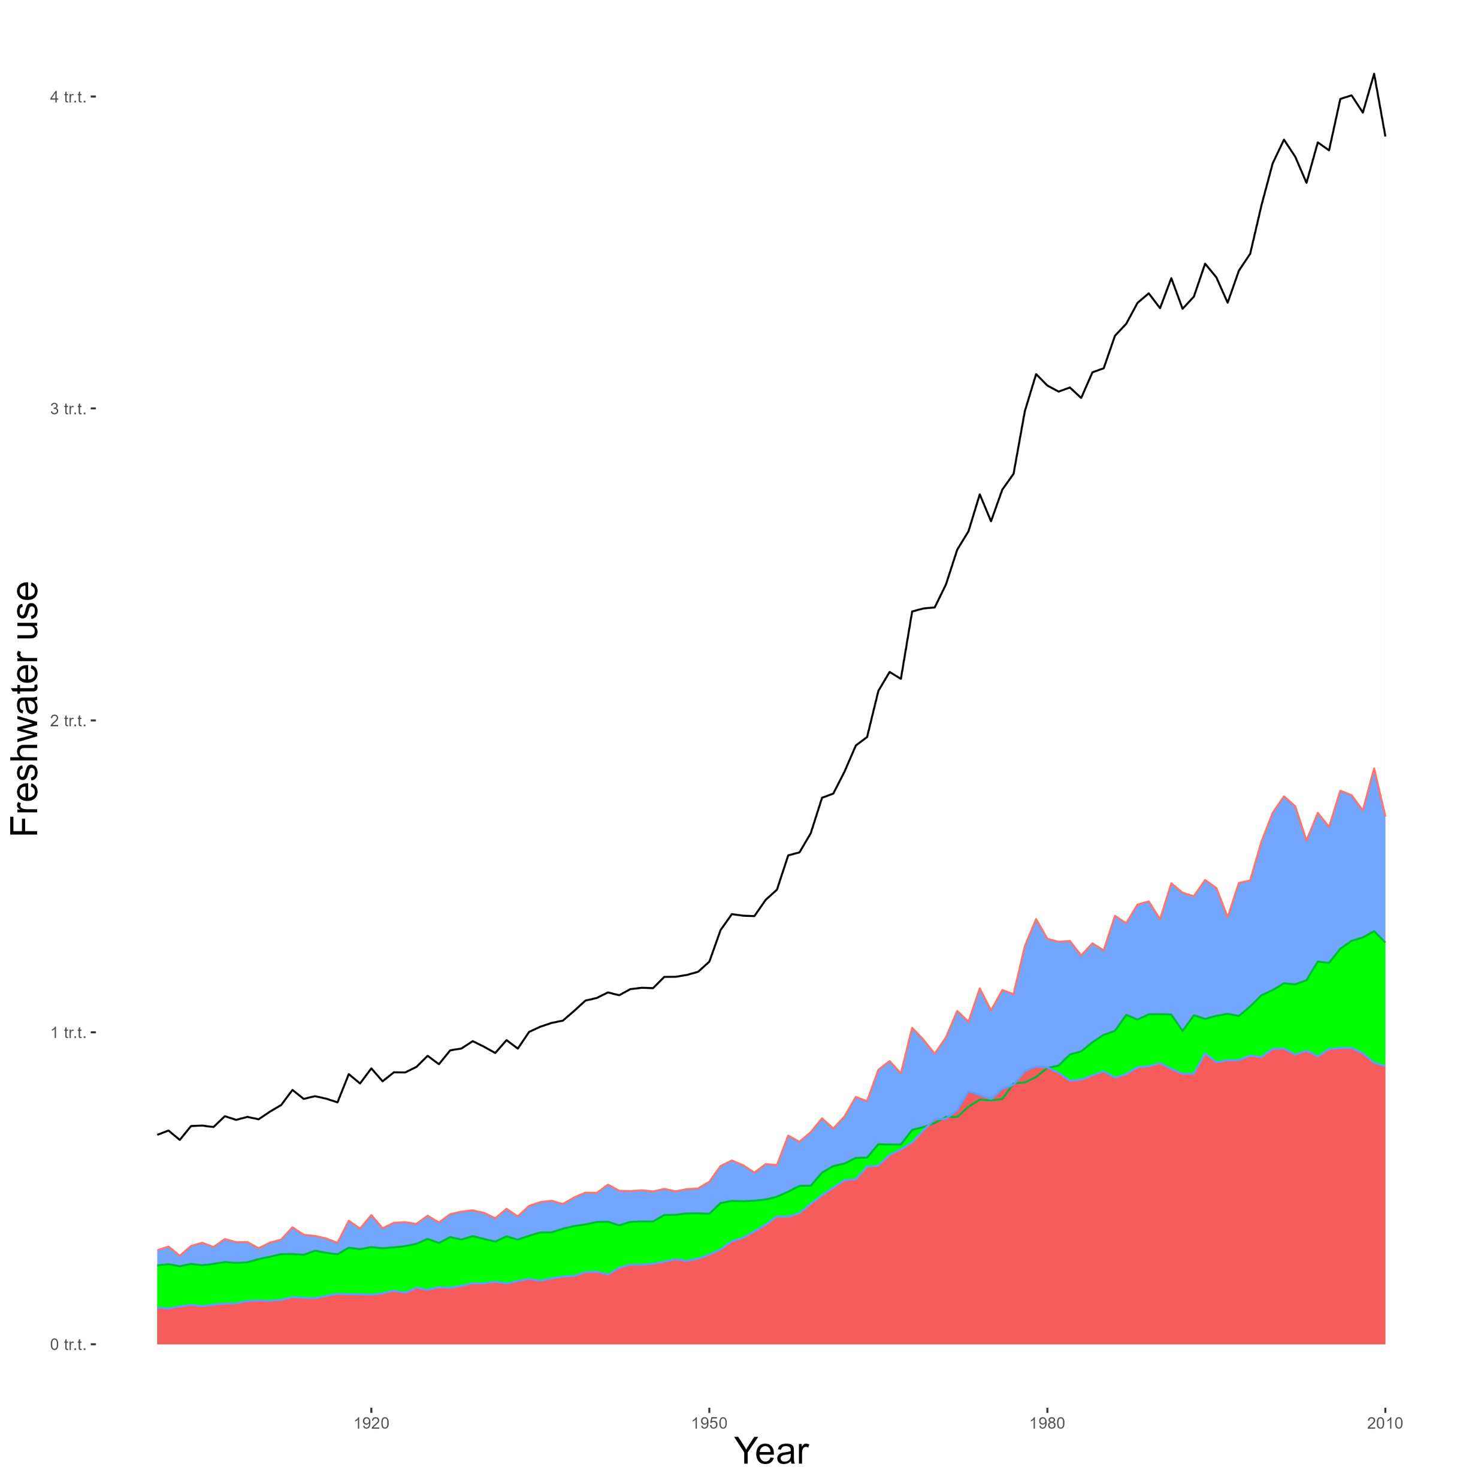
Water consumption
4 tr.t
Overall
BRICS
OECD
ROW
0
1900
2010

Slide 13

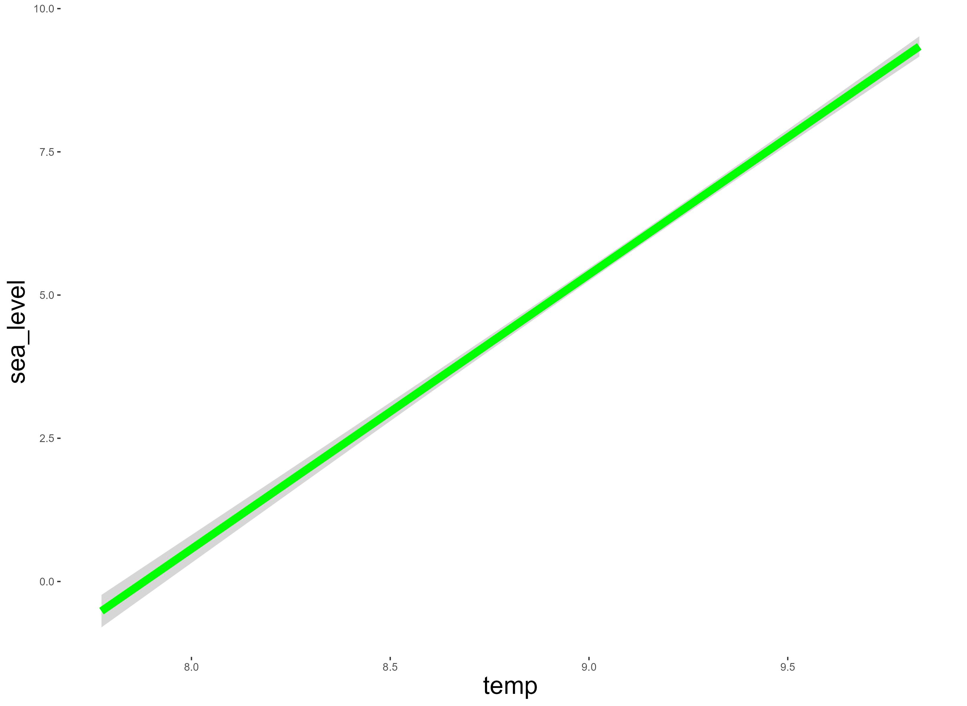
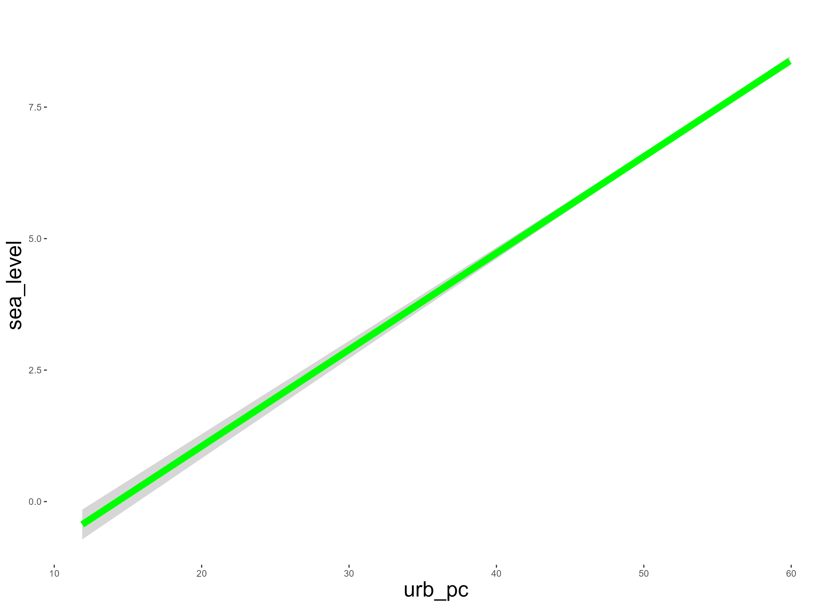
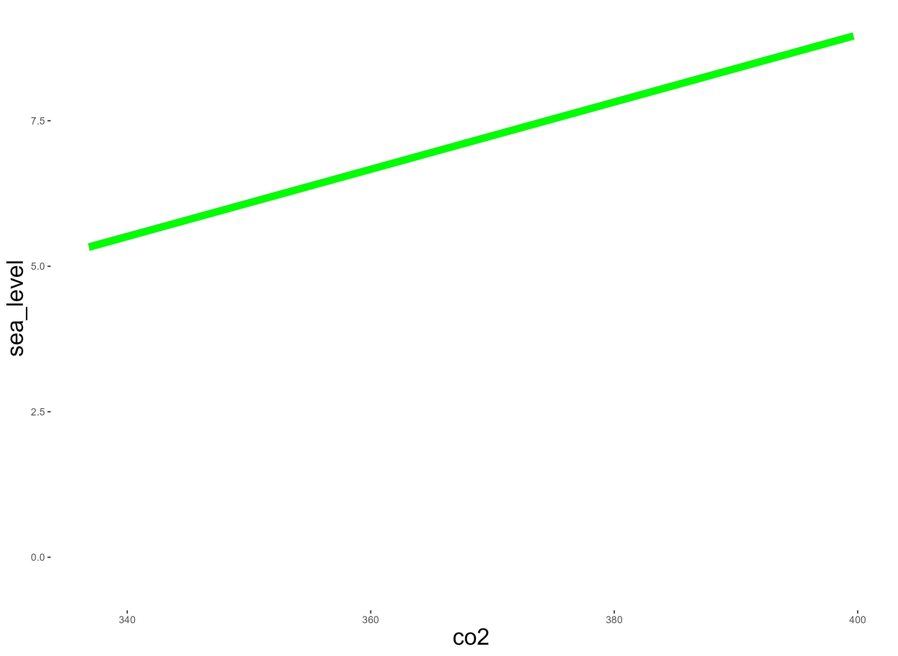
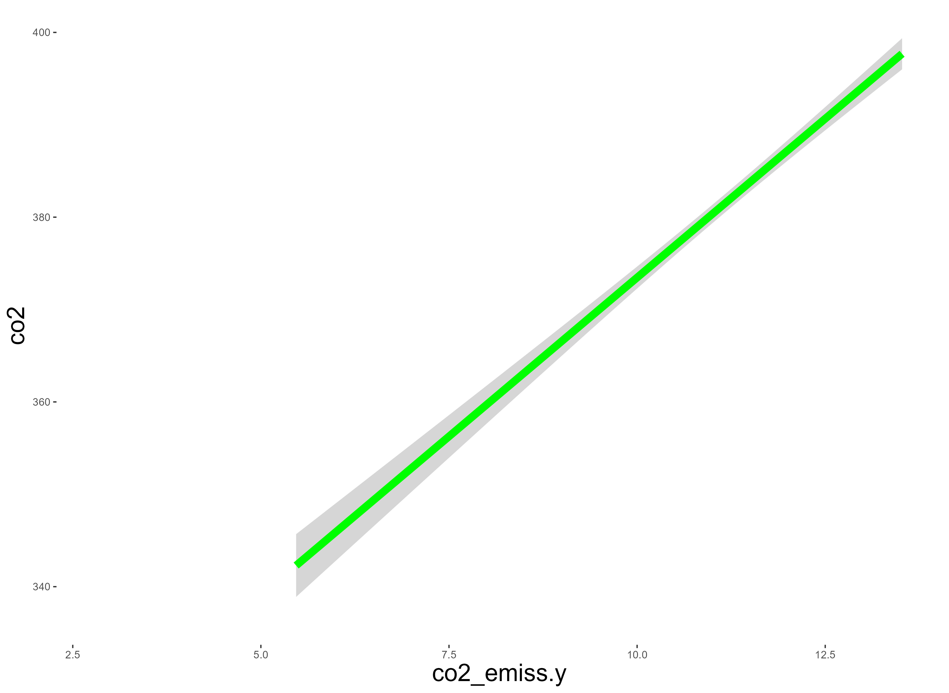
Sea level ~ Temp
Presumably, Climate Indices explain Sea Level Variability
Given that the human influence on nature is increasing, I would like to assess the human contribution to the rise in the level of the world's oceans
Testing this hypothesis can prove the possibility of predicting sea level based on climate data
Sea level ~ Urbanization
Sea level ~ CO2
CO2 ~ CO2 emission

Slide 14

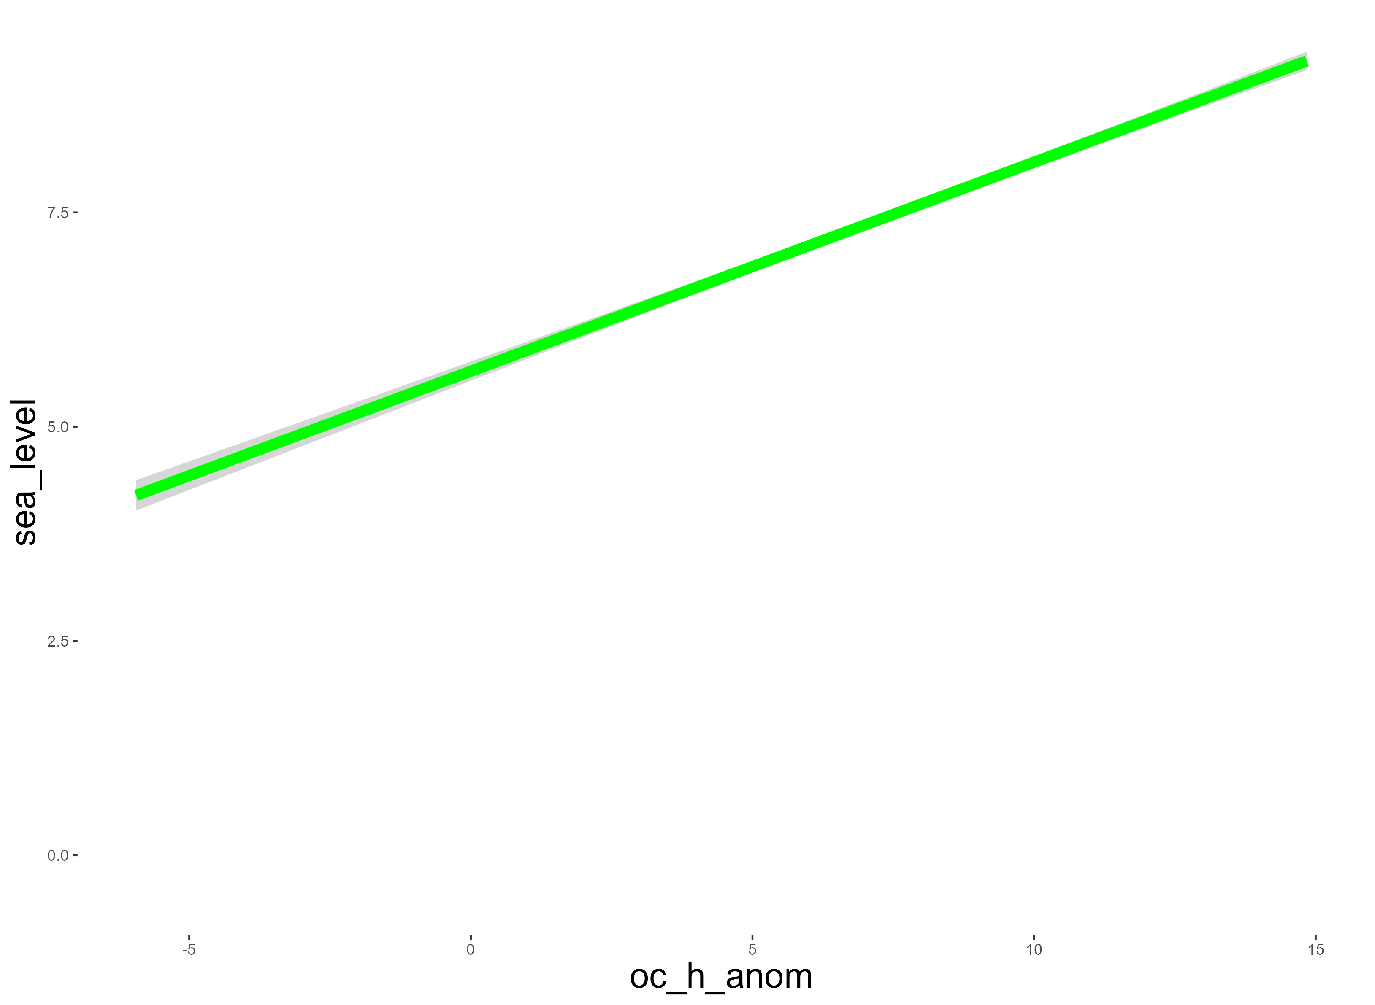
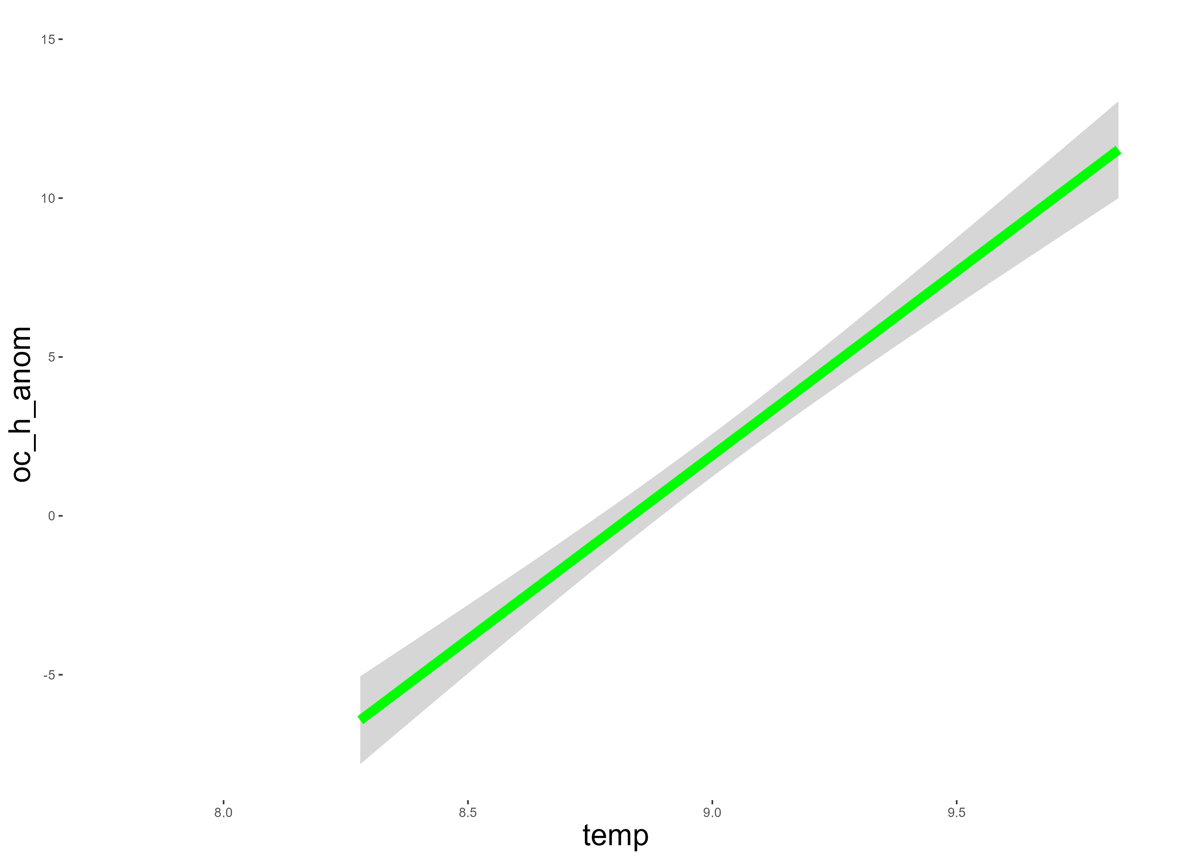
Ocean temps
Sea level ~ Ocean temp
Ocean temp ~ Temp

Slide 15
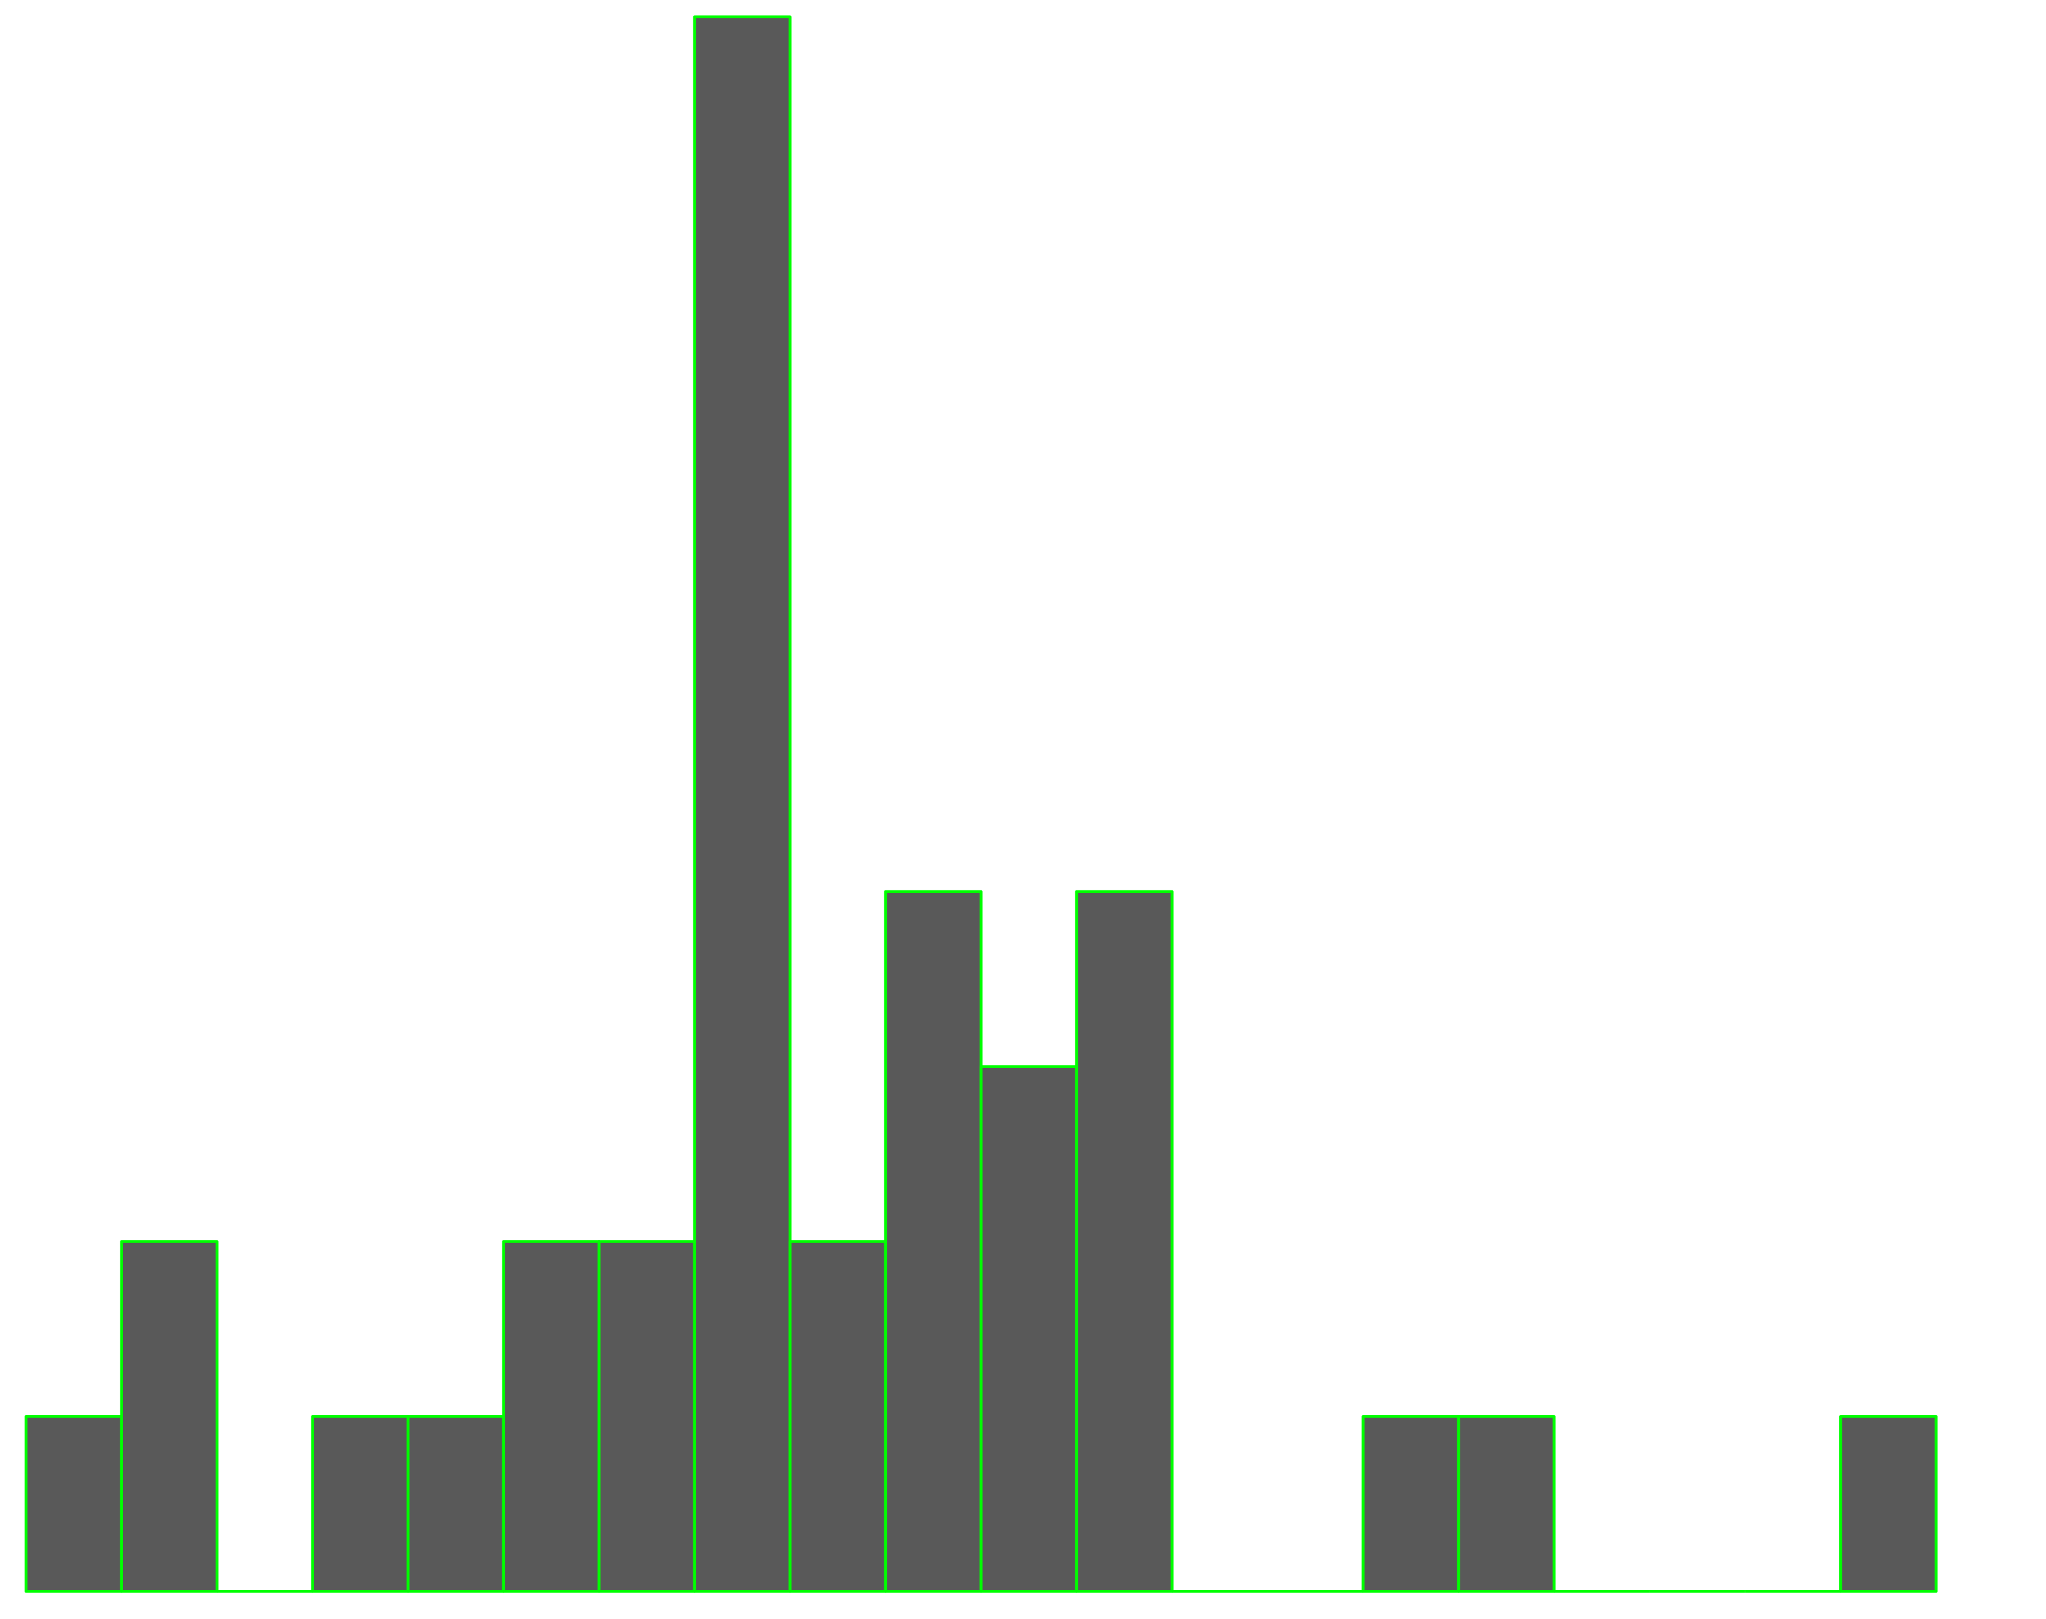
Model OVERVIEW
Residuals:
Min: 0,003
Median: 0.08
Max: 0.28
Bptest (p-value): 0.43
Shapiro-wilk: 0.6
Metrics:
RMSE: 0.15
Rsquared: 0.99
MAE: 0.15
Residuals’ distribution

Slide 16
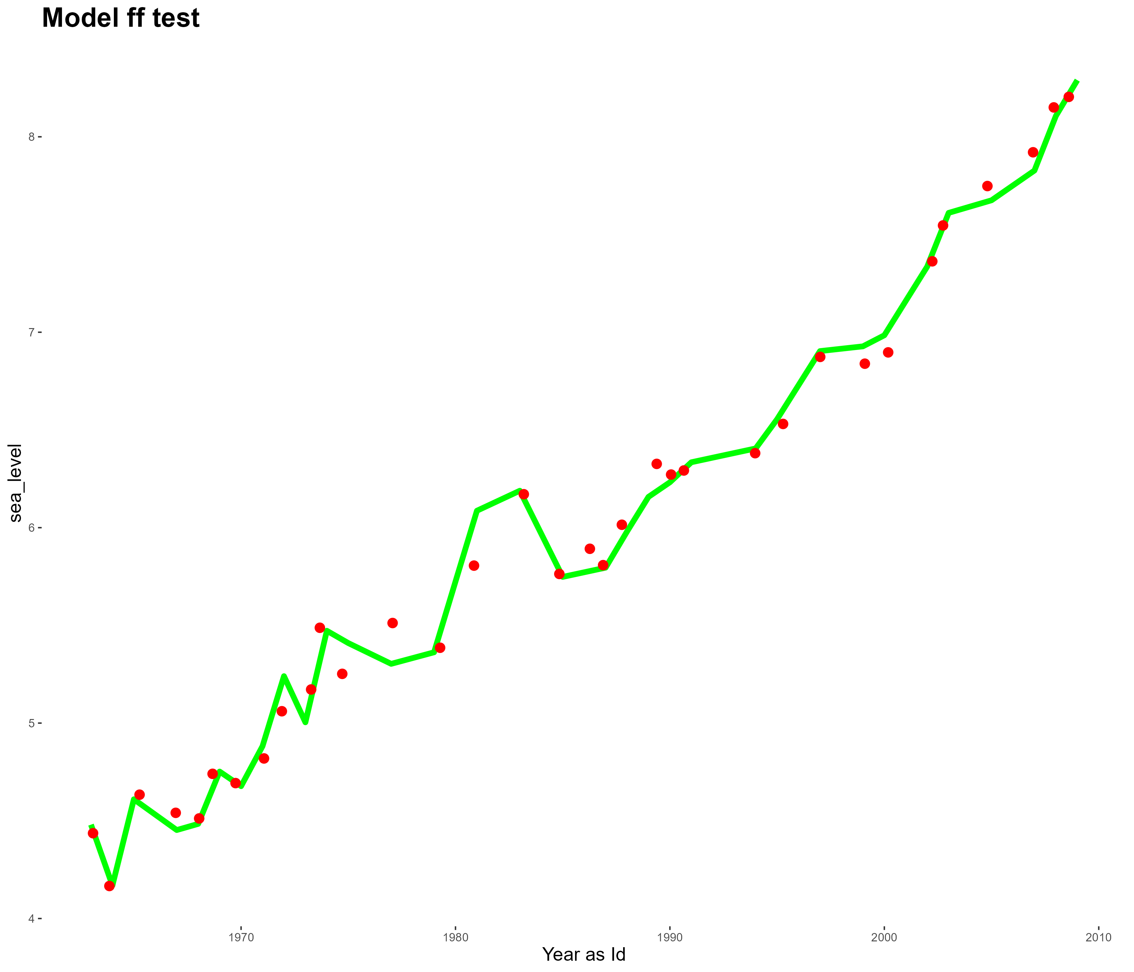
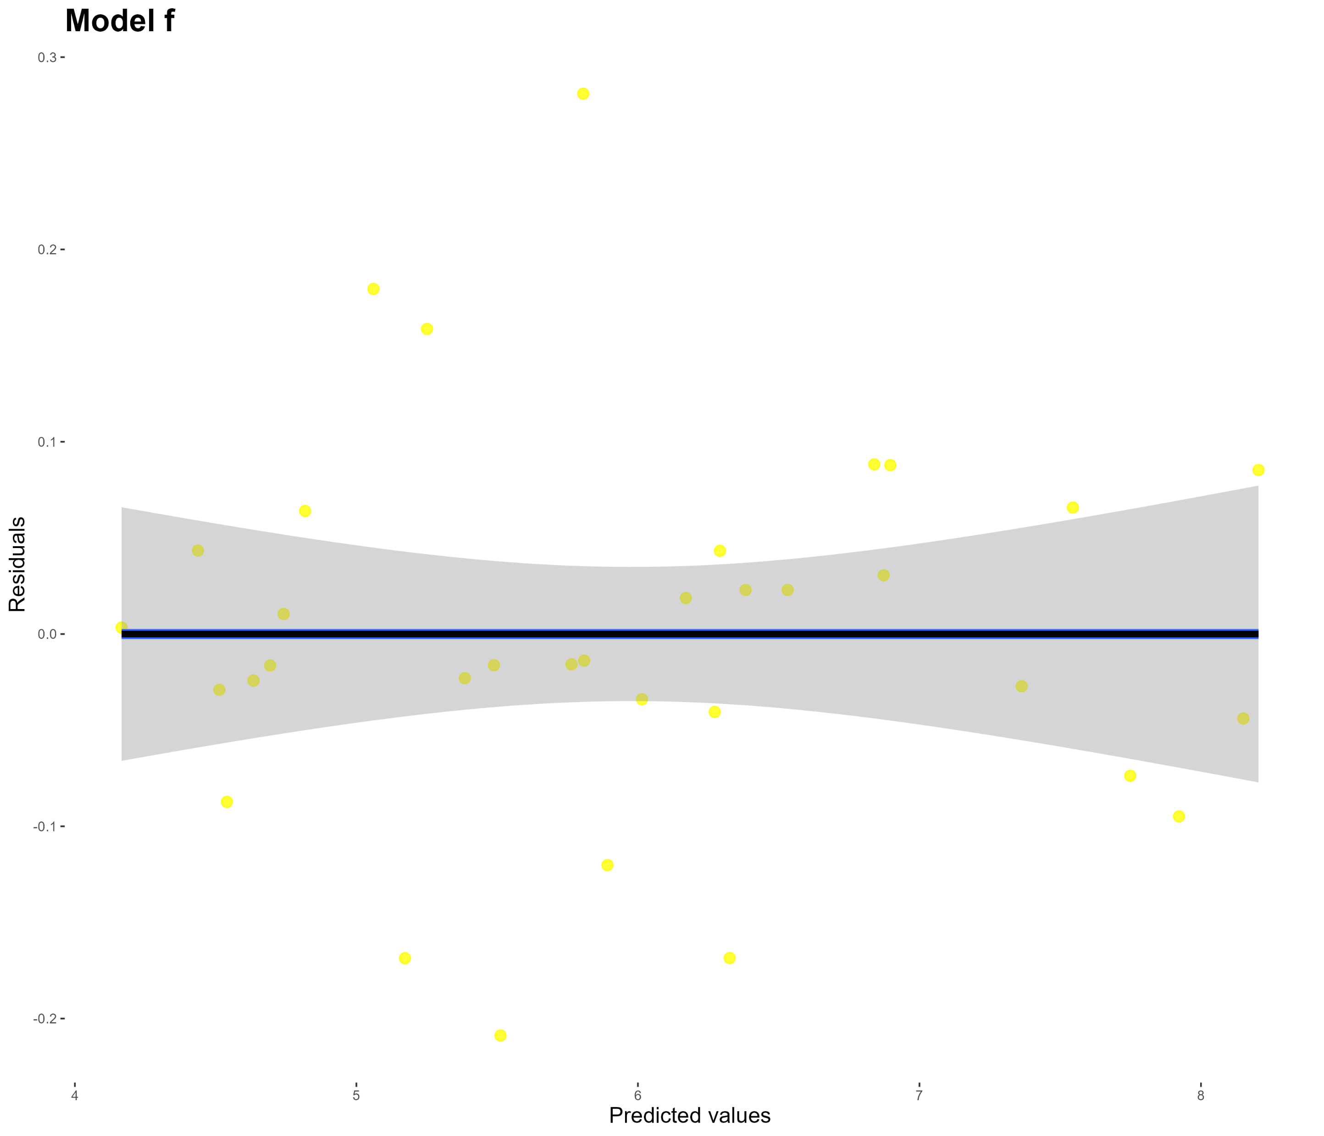
Model OVERVIEW
Green line – real
Red dots – «predicted»
Residuals graph

Slide 17
Conclusions
From the results of the study:
sea level change can be explained in terms of other climatic factors quite successfully
human contribution at the process of sea-level rise is significant
confirmation of global climate change in general is a reason to take measures to mitigate the anthropogenic impact on it and adapt to changes already taking place

Slide 18

Thank you for your time

